Slide 1

Northeast Tennessee Section of the ACS
Mary Engelman Jan 2017

Slide 2
Overview of 4th grade event
2 day event—four sessions
Safety Always First
25 Booths-Get the children involved, Hands on Experience
8 Vendors
Mid Day Show each day
Refreshments for children
Gifts-each child gets a t-shirt and goody bag
Strong link to teachers
Follow-up after event-numerous letters from students-local section members go to schools

Slide 3
26 Years NCW 4th Grader Event
Planning is Key, we start planning 6 months in advance
Always followed the ACS NCW Theme
Local Companies, Universities, other professional organizations and more support (Eastman Chemical, ETSU Chemistry Dept., American Institute of Chemical Engineers, Airgas, and more)
Invite over 161 schools
  Average Schools Respond 38% (62 Replies)
  Average Accepted 40% (25 Schools)
Average attendees is 1400/year- 36,400 students over 26 years.

Slide 4
Do we help?: 4 yrs of statistics
Yes No
O O
O O
O O
O O
I know what Chemistry is about
I think chemistry helps me every day
I plan to take more science in high school
I would like to work for a company that
does chemistry

Slide 5
What have we seen in the data?
NCW has had a positive impact
  Students learn what chemistry is about
  They recognize that it helps them daily
  Interest in working for a chemical company
> 4500 Students polled.
> 1800 positively impacted
Some Factors:
  No difference in responses based on Male/Female
  Differences in responses across rural vs. city school systems

Slide 6
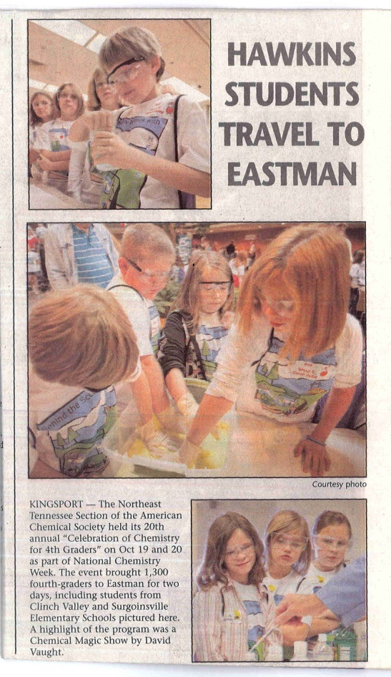
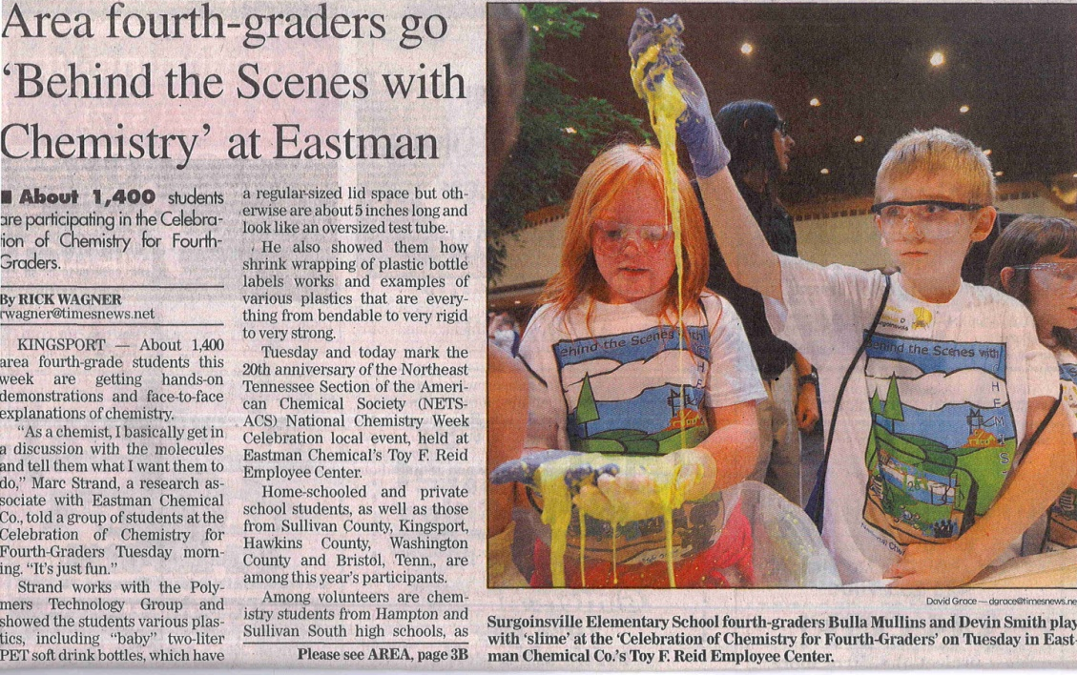
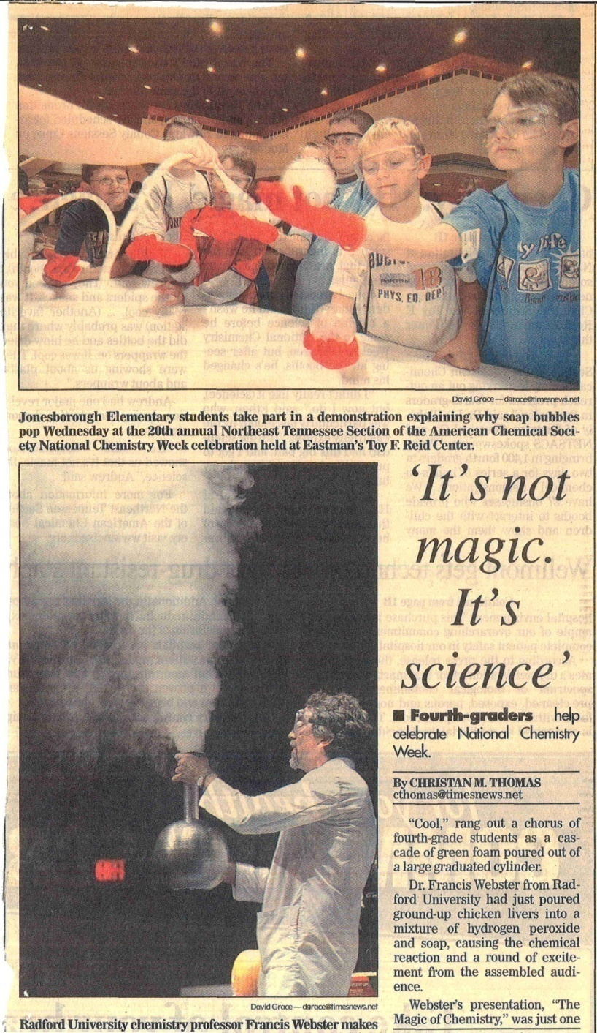
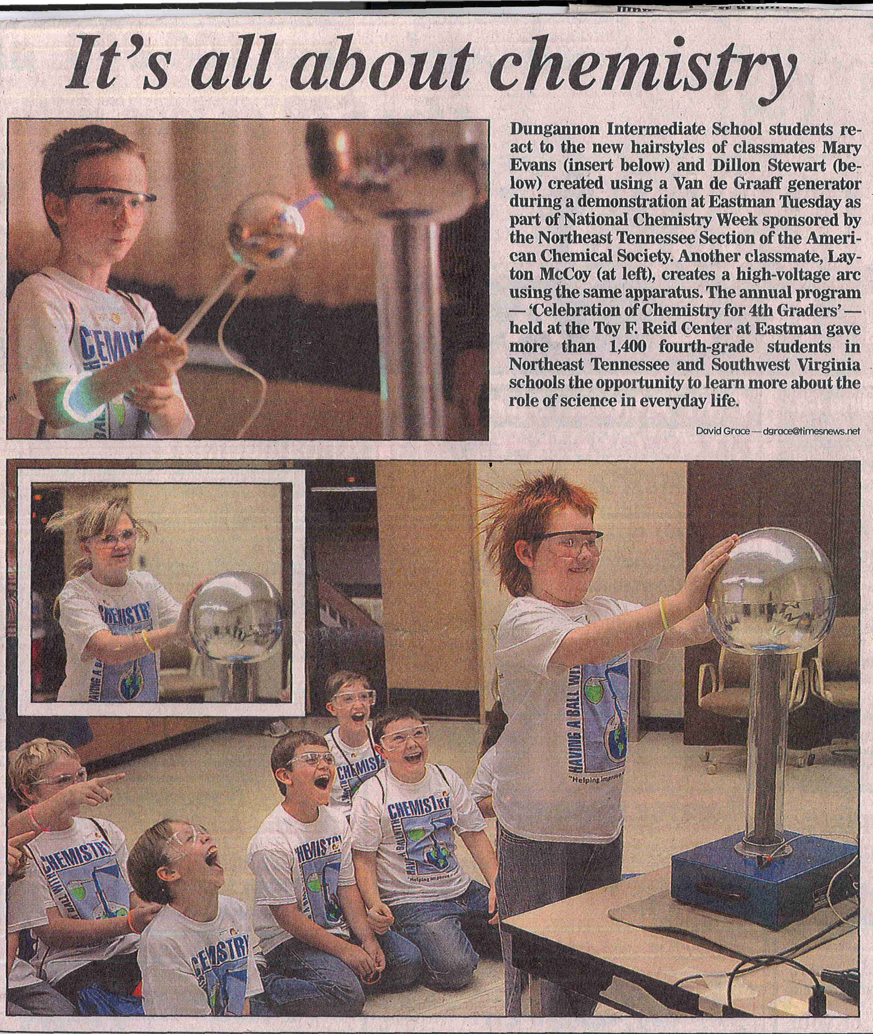
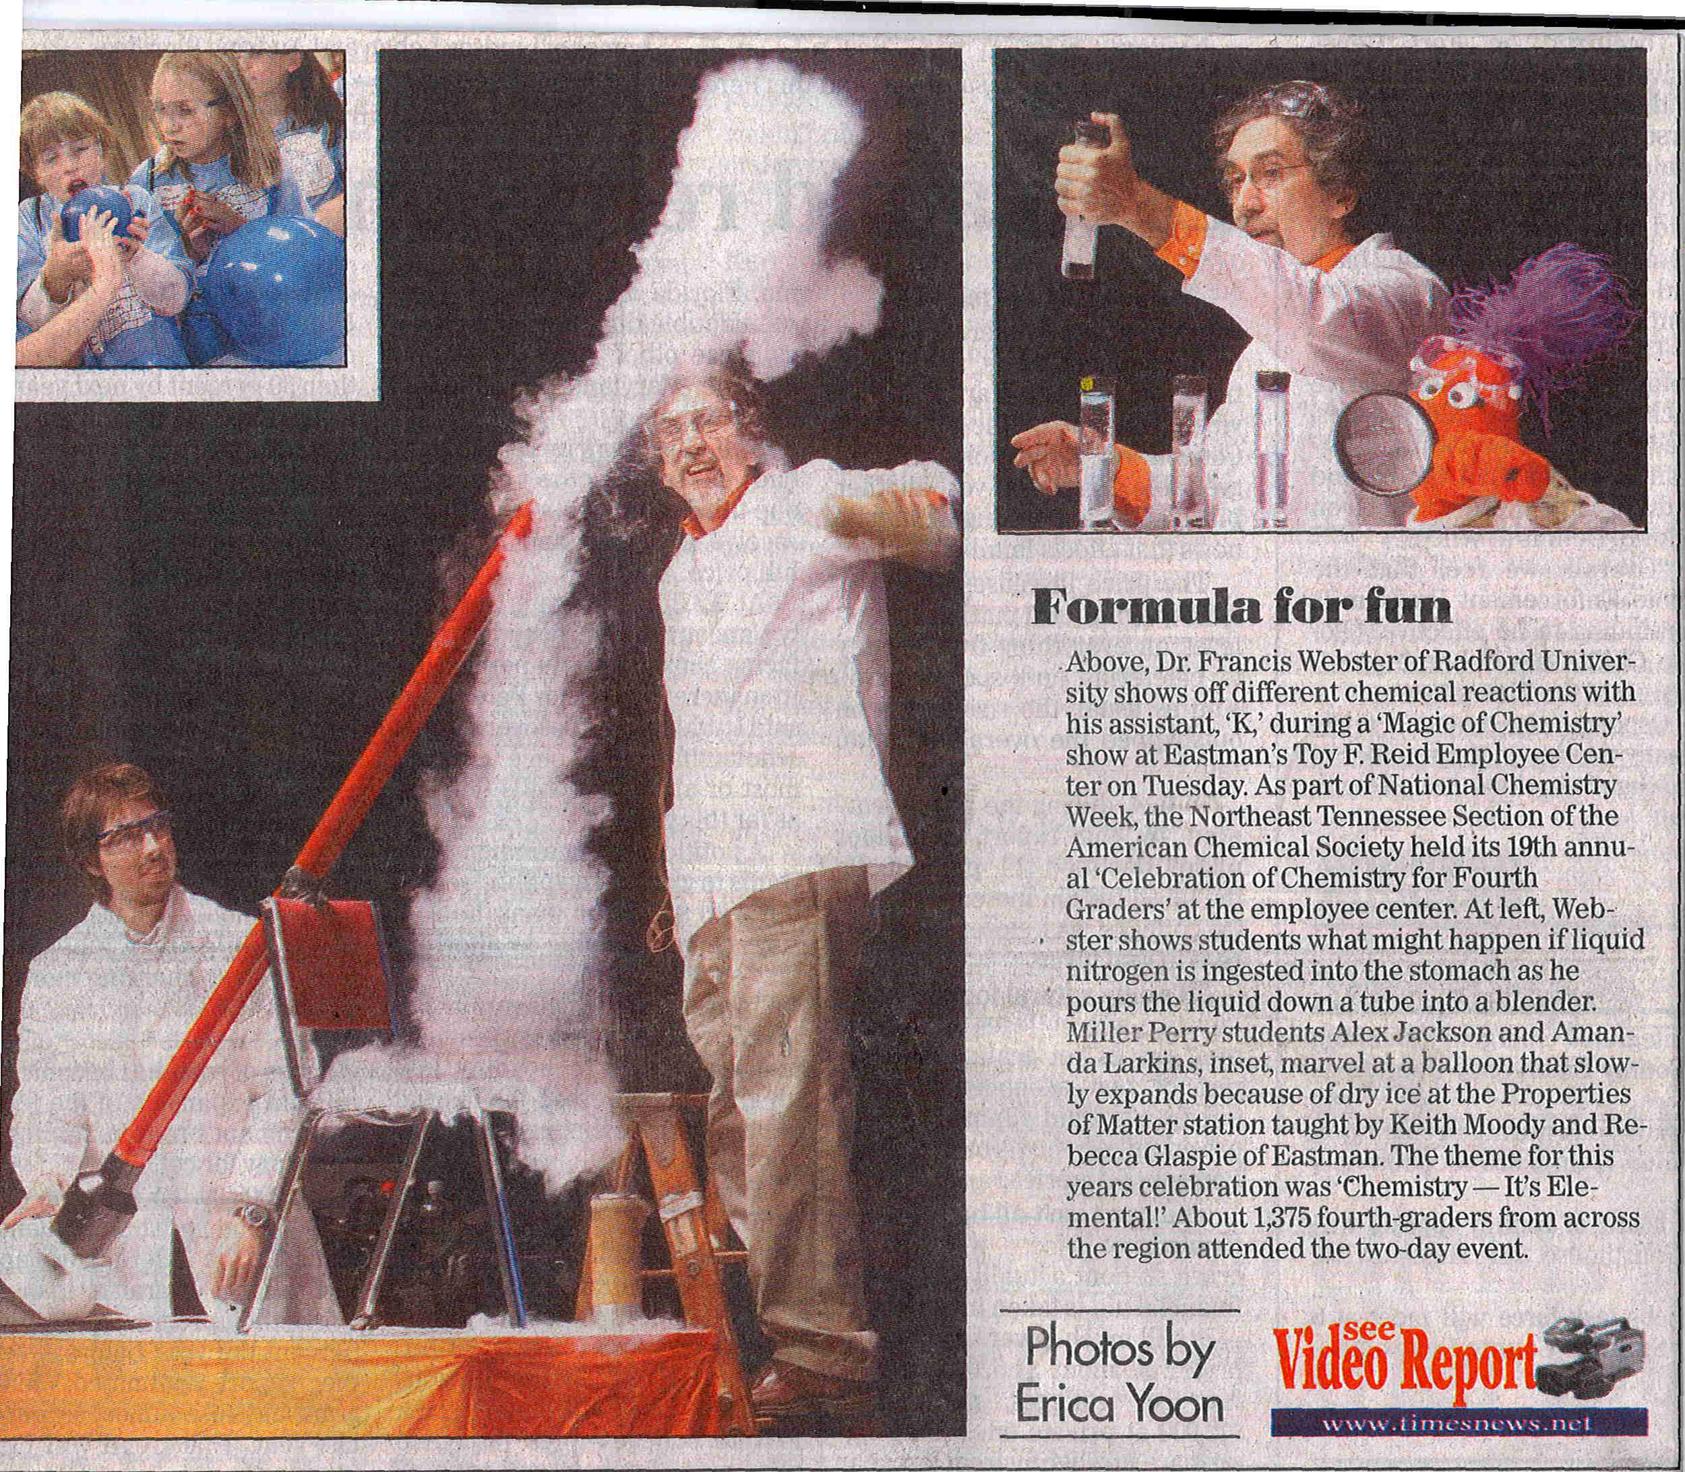
Organization: Public relations

Slide 7
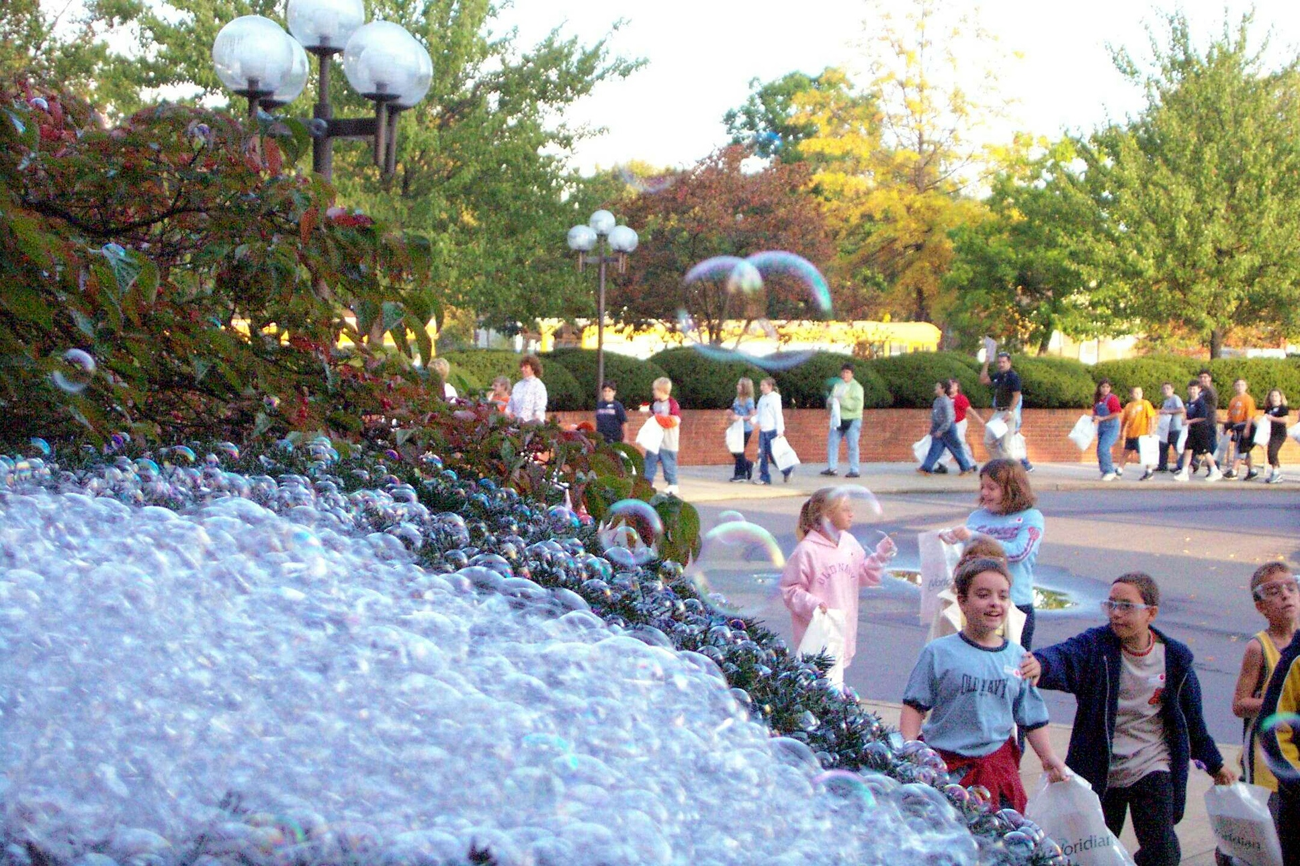
This is why we do NCW

Slide 8
ChemLuminary Award
ACS Climate Science Toolkit-Based Activities
of the DFW Local Section.
ACS Climate Science Toolkit-Based Activities
of the DFW Local Section
Reporter: R. G. (Bob) Landolt
Emeritus Professor of Chemistry
Texas Wesleyan University

Slide 9
Milestones
“Climate Science Is the Answer
But What are the Questions?”
Funded by 2013 ACS Challenge Grant,
$3000 -National ACS + $3000 Local Section Match
Activities:
  Community College Faculty Symposium
  Sustainability Session at SWRM
  CAST Teachers Workshop (2015)
  Conference for Advancement of Science Teaching

Slide 10
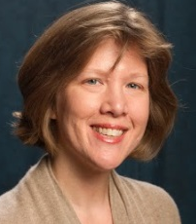
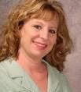
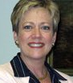
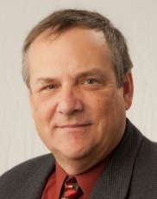
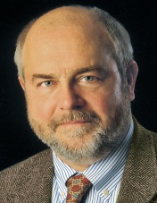
Key Players
Gilchrist Coffman Mouchayleh Nielsen-Gammon Baum
Lessons Learned
“To err is human, to bore is unforgivable!”*
    So, Tell a Story!
*R. Olson, et al, “Connection-Hollywood Storytelling meets Critical Thinking,” 2013
Use Humor Whenever Possible!

Slide 11
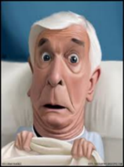

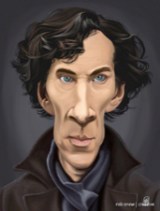
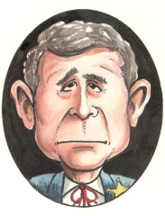

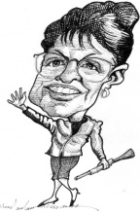
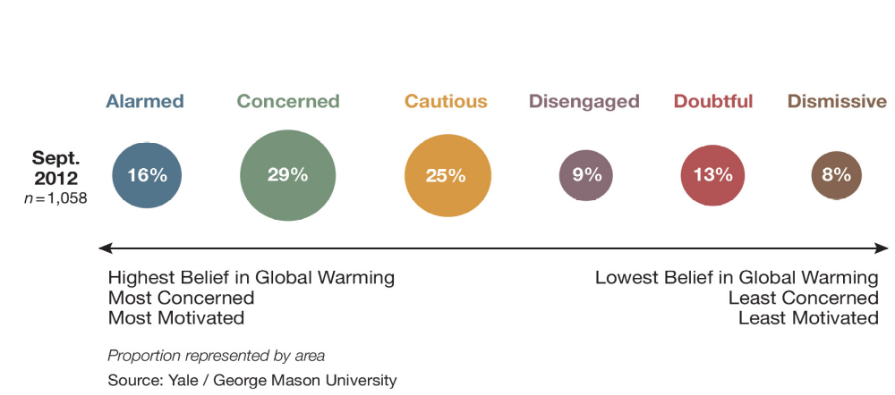
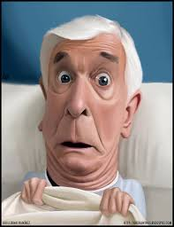
The Six Americas Audience Segments
American Public Opinion
http://environment.yale.edu/climate-communication/files/
Six-Americas-September-2012.pdf

Slide 12
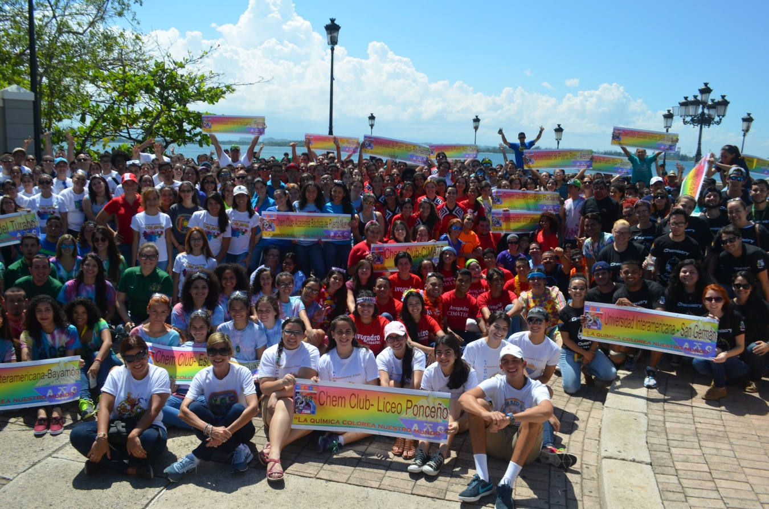
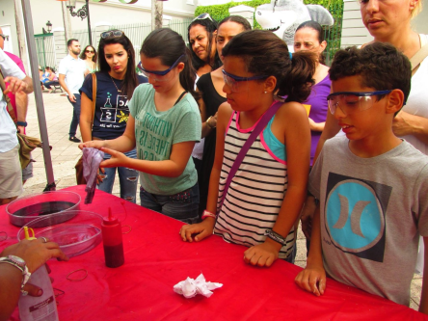
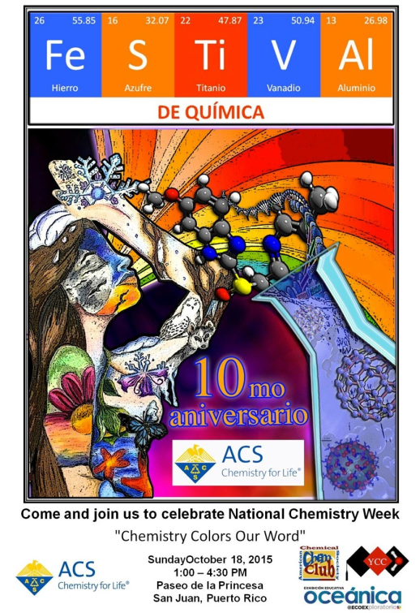
Outstanding High School Student Program Award
Puerto Rico Local Section

Slide 13
Activity: Participation of High School Students in Festival de Quimica – National Chemistry Week
Organization:
  Local Section Membership Committee
  Students’ Chapters
  Dr. Ingrid Montes – Coordinator National Chemistry Week
  Dr. Edmy Ferrer – Chair 2015
Objectives
  Communication between Students’ chapters and High School Chemistry Clubs
  Enhance volunteer participation of members

Slide 14
Funding resources
Local Section
Lilly Company

Slide 15
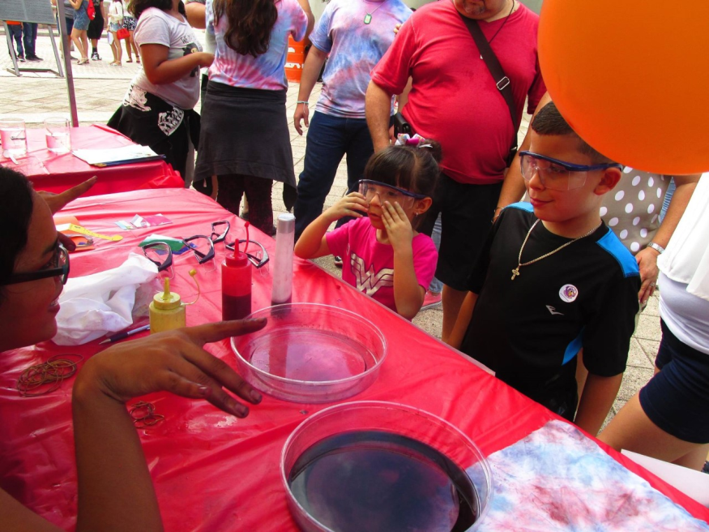
Impact and assessment
Nearly 150 high school students and 20 teachers served as volunteers during this exciting community activity.
The community participated in the chemical demonstrations activities conducting hands on experiments.

Slide 16
Local Section Partnership Award 2015 Partnership Between
Tampa Bay & Puerto Rico
Presenter: Crystal Saut
Author: Dr. Kimberly Fields

Slide 17
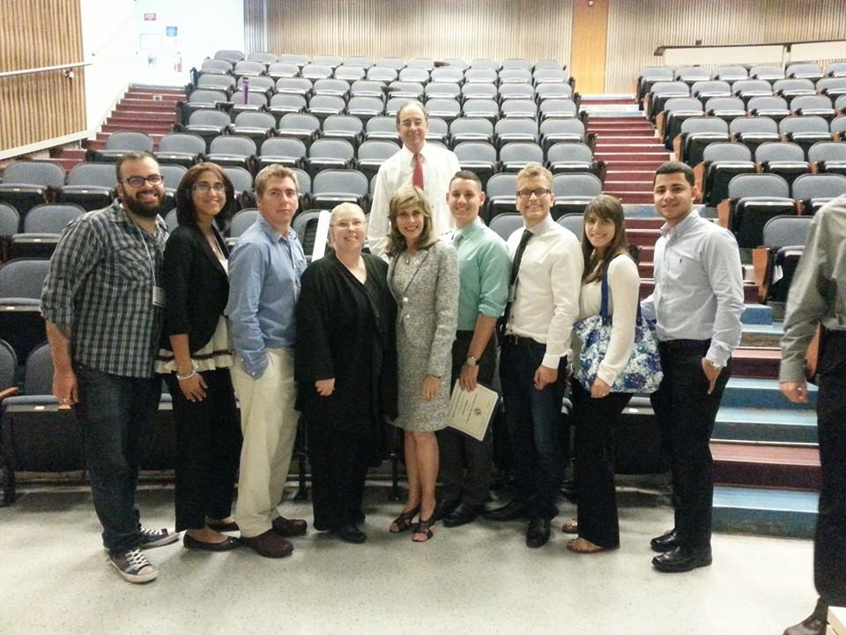
Group with the ACS Bridge the Gap Nano grant
Dr. Kimberly Fields from University of South Florida, Dr. Ingrid Montes from University of Puerto Rico, and her student Giovanni plus Interamerican Univ. of Puerto Rico students Marco, Lenianne, Gabriel, and Keishla.

Slide 18
The five undergraduates from Puerto Rico presented their posters.
OR-25 Giovanni Rodríguez1 – Synthesis of Novel Ferrocene Chalcones Derivative’s Polymers
BP-06 Marco A. Miranda Belandria1 - Functionalization and characterization of bimetallic silver-gold nanoparticles with antibiotics.
BP-05 Ramirez Santiago, Lenianne1 - Comparative study and characterization of MgO, ZnO AND CuO nanoparticles using amino acids as capping agents.
BC-09 Keishla Rodríguez Graciani1 - Antimicrobial effect of improved antibiotics combined with Ni and Semi-Green Ag nanoparticles in Klebsiella pneumoniae.
BC-10 Maldonado Vélez Gabriel¹- Functionalization of Indole-3-Acetic Acid with gold nanoparticles synthesized through a double reduction reaction using leaflets’ extracts of Leucaena leucocephala (Lam.) de Witt.

Slide 19
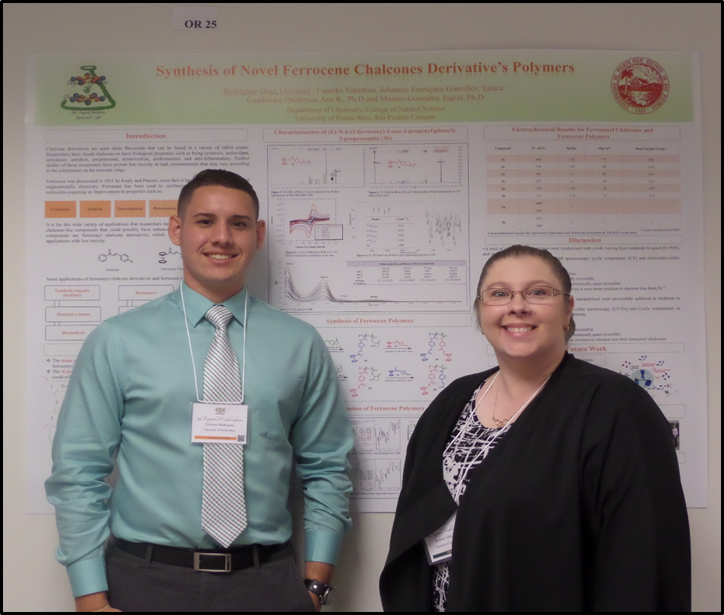
At the Raymond N. Castle Student Research Conference Giovanni Rodriguez with Dr. Fields, won third in the organic division competition.

Slide 20
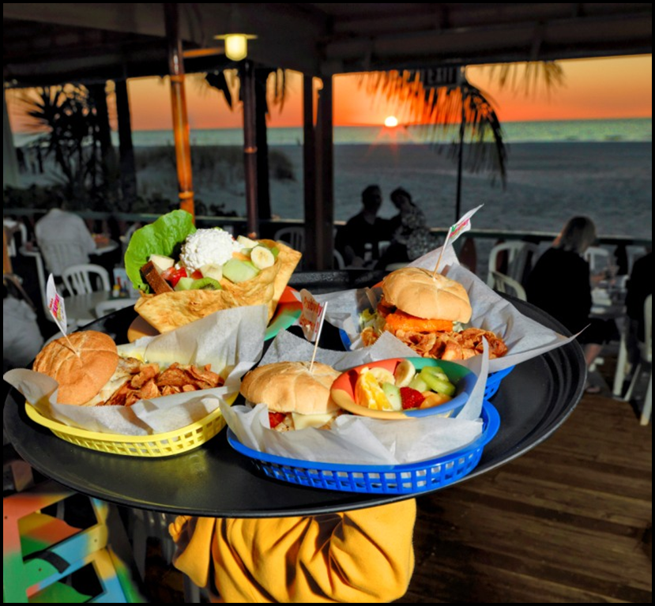
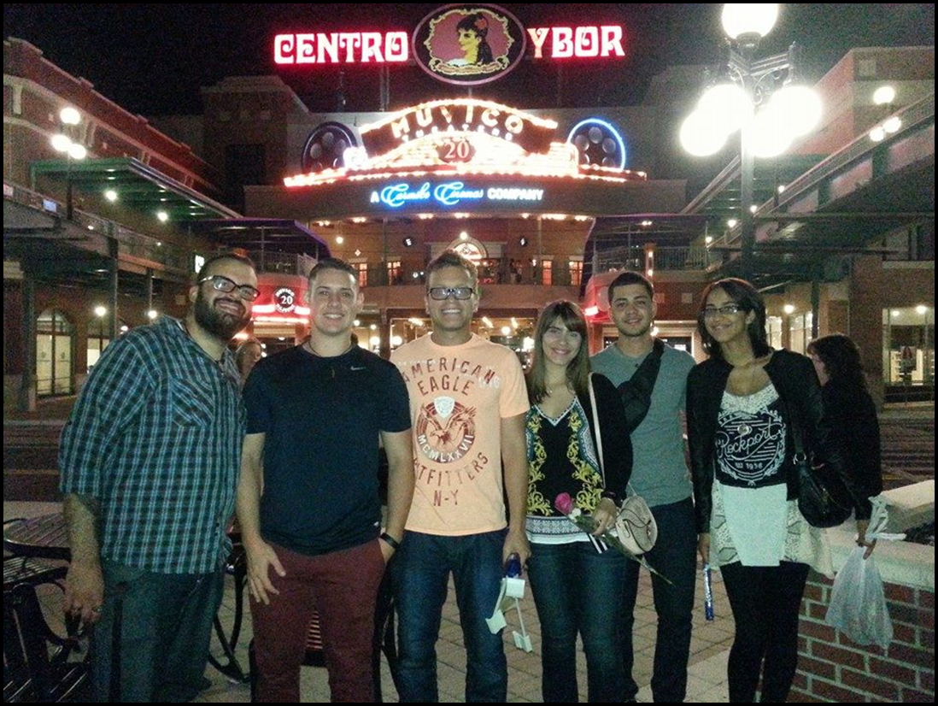
Enjoying the highlights of Tampa Bay.
On Friday, Dr. Ingrid Montes from University of Puerto Rico and Puerto Rico students arrived, & had dinner with volunteers from the USF Chemistry Society at Frenchy’s Rockaway Grill in Clearwater, FL.
After the conference ended, the five students and Dr. Montes were escorted to Ybor by TB-ACS chair Dr. Fields, USF Chemistry society students & their adviser Dr. Cruz.

Slide 21
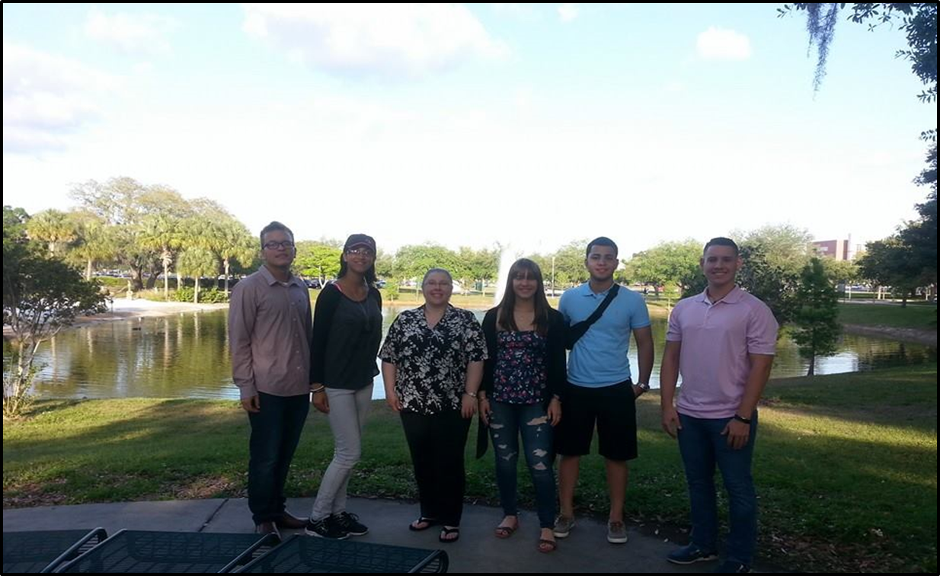
The six guests from Puerto Rico flew out on Sunday morning for their return home.

