Slide 1
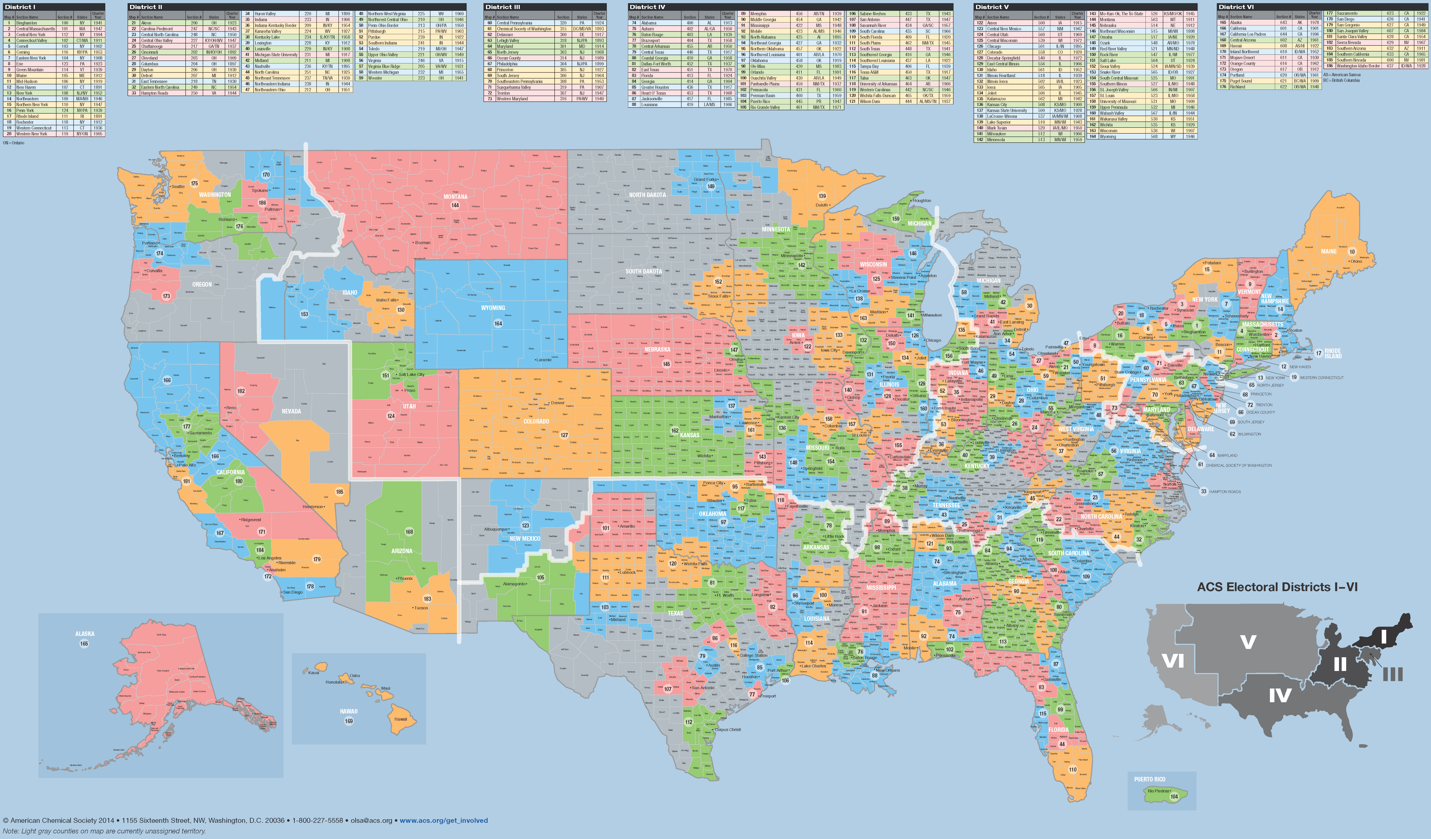
ACS Local Sections: We are EVERYWHERE
Small: 54 Medium Large: 20
Medium Small: 46 Large: 13
Medium: 45 Very Large: 7
Notes:
ACS Local Sections are Everywhere.
As you can see from the map, the ACS local sections are spread all across the country, and are split into six regions (based on membership numbers).
At the Leadership Institute, you will have a chance to meet some of your neighboring, regional sections during the Friday afternoon program.
Involvement of ACS members, at the local section level, helps the ACS achieve its six strategic goals

