Slide 1
Communicating with your Local Section Members
ACS Leadership Institute ● Dallas, Texas
January 27-29, 2017
Angela Morris, Senior Membership Associate
Charles Cannon, LSAC
Notes:
WELCOME & INTRODUCTIONS

Slide 2
LSAC Communications Subcommittee Overview
Focus: Broad-based communications among LSAC, Local Sections, and other relevant stakeholders
Vision: To become an essential partner in providing access to resources that facilitate and support enriched engagement with key stakeholders
Mission: The LSAC Subcommittee on Communications (COM) provides access to and advice about communications resources that facilitate and support enriched engagement among LSAC, Local Section Leadership, and other relevant stakeholders

Slide 3
What To Expect
Information to aide your Local Section with online communication services offered from ACS and how to implement them.
Notes:
What participants can expect from this session.

Slide 4
Available Online Communication Tools & Services from ACS
Online web-hosting solution provided through our partner, Webs.com
Email management service from Real Magnet
The Volunteer Support and Engagement (VSE) Group on the ACS Network (a social portal for user-generated content for Local Sections’ online and hard-copy communications)

Slide 5

Online Web-Hosting Solution
Webs.com
  Update your information regularly
  Use it in conjunction with any social media efforts (ACS Network, Facebook, Twitter, etc.)

Slide 6
Online Web-Hosting Solution
In 2009 – to meet the needs of our Local Sections and Technical Divisions, ACS partnered with webs.com to provide a free, online web-hosting solution.
To date, 117 Local Sections have signed up for the service
Is your section using the service? Ask us if you’re not sure.

Slide 7
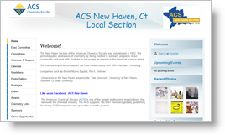
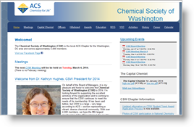
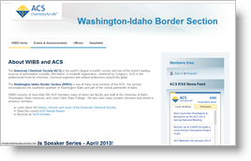
Online Web-Hosting Solution
Main benefits of the service include:
ACS branded, easy to use templates

Slide 8
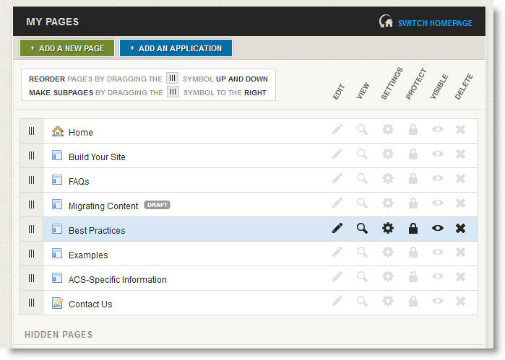
Online Web-Hosting Solution
Main benefits:
A user-friendly web editor (no need to know HTML)

Slide 9

Online Web-Hosting Solution
Main benefits:
Ability to easily hand over web administration duties from one person to another

Slide 10
Communicating with your Members and the Public
Use your website to:
  Tell your origin story (where, when, why and how?)
  Post your Annual Report (include a compelling summary)
  Post announcements and results of activities
  List your Local Section Officers
  Share an events calendar (keep it updated)
  Provide first-hand accounts from members
  Keep an image gallery from events
  Post local job listings perhaps not easily found on your typical job search site
  Devote a full page to volunteer opportunities for members
Notes:
Having an updated website, even if your section does not have a lot of information to post or if you’ve decided to use more social media in your communications, can still serve as an excellent entry-point to your Local Section's full complement of online communications/services and can provide content that doesn't necessarily fit into a third party data model (Facebook, Twitter, etc).
Use your website to:
- Tell your origin story (where are you located, when was your section founded and why, how many members do you have and what are some their shared characteristics, if any?)
- Post your Annual Report (include a compelling summary)
- Post announcements and results of activities
- List your Local Section Officers
- Share an events calendar (keep it updated)
- provide first-hand accounts from members
- Keep an image gallery from events
- Post local job listings perhaps not easily found on your typical job search site
- Post volunteer opportunities for members (working with kids, schools, section events, science cafés, etc.)

Slide 11

Communicating with your Members and the Public
In 2016, 169 out of 185 Local Sections have websites linked from the ACS Get Involved, Stay Involved webpage for local section websites.
Notes:
How many of you here know if your Local Section has a website?
What would prevent you from posting your section’s annual report? What are some of the benefits of posting your annual report on your website?

Slide 12

Notes:
Does anyone have any questions?

Slide 13



Communicating with your Members and the Public
What is the primary mode of communication used to communicate to your members?
Notes:
How many of you use email as the primary form of communication to members?

Slide 14
Communicating with your Members and the Public
When used properly, a mass email service can:
Build trust with your members
Keep your contacts organized
Enable access to email campaign reports (analytics), measure your results after every email campaign
Meet the requirements of the CAN-SPAM act (avoid having your emails get stuck in SPAM filters)
Notes:
Benefits of Mass Email

Slide 15






Email Service Providers
Notes:
Some popular email service providers. Do any of you have experience with using any of these services? Tell us about your experience…

Slide 16
Email Management Service
Real Magnet
  Using a mass email service is more effective than using a personal email account
  Local Sections utilize Real Magnet by inserting and creating Newsletters
  To meet the critical needs of our members, ACS has partnered with Real Magnet to offer a free, mass email service for local sections and technical divisions.
Notes:
If your local section or technical division is interested in this type of service to better target your audience and improve your online communications, please email EMS@acs.org.

Slide 17
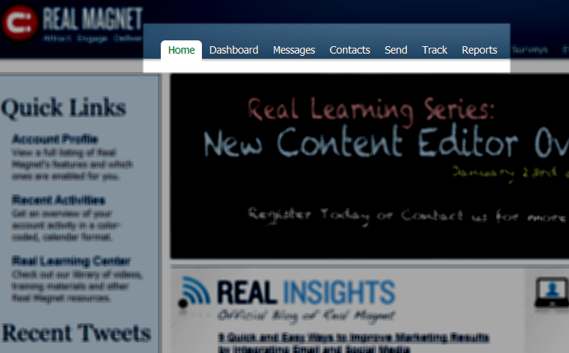
Email Management Service
Main benefits of the service include:
Individual account with intuitive dashboard

Slide 18
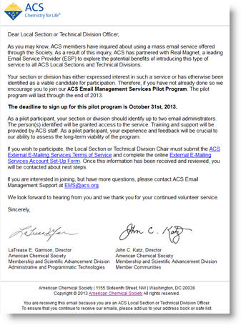
Email Management Service
Main benefits:
ACS branded template to put your message within

Slide 19
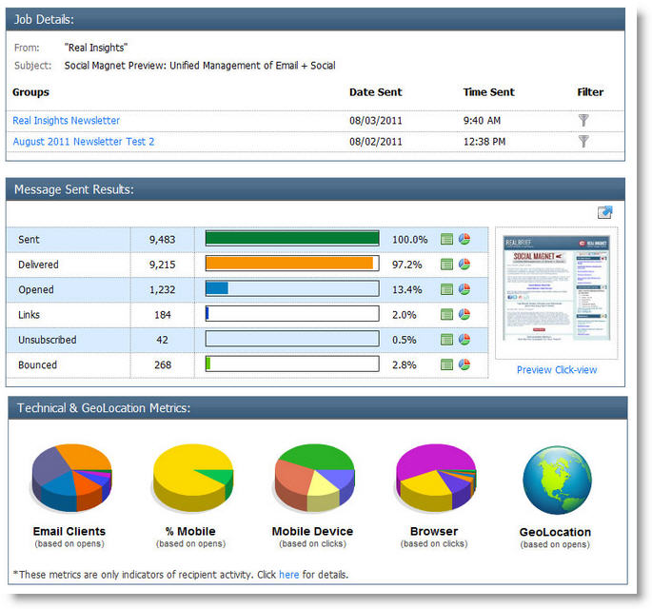
Email Management Service
Main benefits:
Message tracking - insight into a message’s performance, with all the key metrics (delivery, open rate, clicks, bounces and unsubscribes) represented both numerically and graphically.

Slide 20
Email Management Service
Use your current email address or any pre-existing email address
Download lists, i.e. from eRosters and upload into Magnet Mail
  you’ll need to update the list each time you send a new email.
You will upload your lists to 1 of 2 Groups in Magnet Mail:
  Promotional emails, i.e. invitations to events, general communications and info (must have the opt-out option for promotional emails)
  Administrative emails, i.e. elections and governance meetings, etc.
Designate up to 2 email administrators
Interested in signing up for the service? Contact EMS@acs.org

Slide 21
Other Offered Services
Phone
  Consider A+ Conferencing for special rates for Local Sections
In-person meetings/events: Local Section or ACS Regional Meetings

Slide 22
Notes:
Does anyone have any questions?

Slide 23
ACS Network for Local Section Activities
Notes:
Emphasize the network is the Social Media Tool of ACS

Slide 24
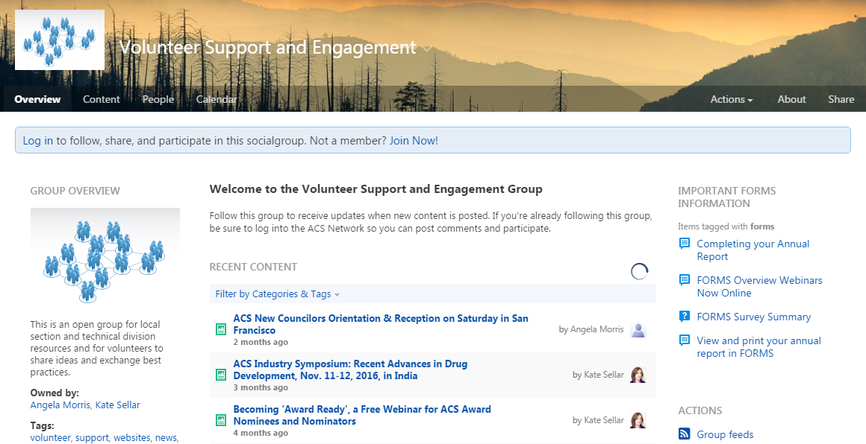
ACS Network:
Volunteer Support & Engagement
https://communities.acs.org/groups/vse
An open group where pertinent information for dedicated ACS members can be found, posted, and shared.
Notes:
*Encourage volunteers to join this group if any because it’ll be the most helpful for them as a tool
THIS NEEDS TO BE UPDATED: In addition to our Online web-hosting solution, there is also an public group on the ACS Network called “Volunteer Support and Engagement” where pertinent information for dedicated ACS members can be found. Members can also share ideas, ask questions and exchange best practices.

Slide 25
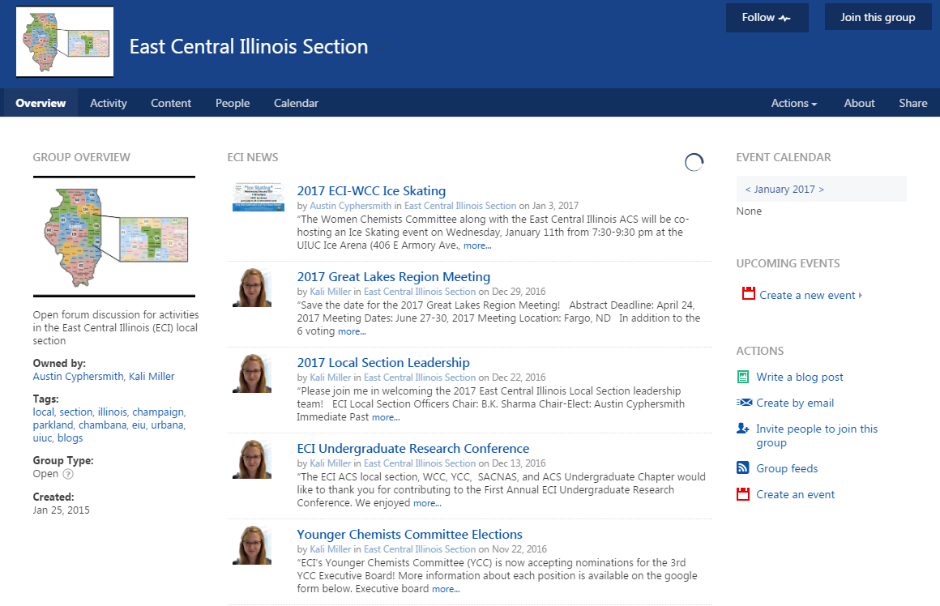
Actively Engaged Local Sections
Section members can create public places to advertise upcoming meetings and events.
Notes:
Actively engaged local sections can create public places to advertise upcoming meetings and events.

Slide 26
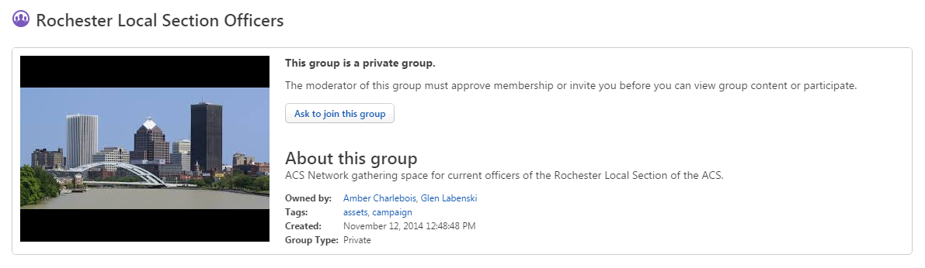
Actively Engaged Local Sections
Section members can create private groups to collaborate on work.
Notes:
Actively engaged local sections can create private groups to collaborate on work.

Slide 27
Notes:
Does anyone have any questions?

Slide 28
How to Contact
Online web-hosting solution:
webhosting@acs.org
Email Management Service (EMS):
ems@acs.org
ACS Network:
acsnetworkfeedback@acs.org
Angela Morris, Senior Membership Associate Local Section & International Chapter Support a_morris@acs.org

Slide 29

Thank
You!
Notes:
end

