Slide 1

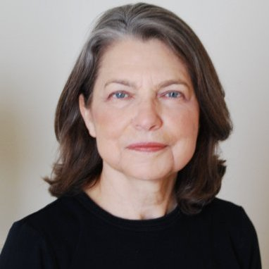
Planning Successful Activities
Session Leaders:
Tracy Hamilton, Alabama Local Section
Louise Lawter, Princeton Local Section
Notes:
Tracy starts – as participants are getting organized, we all help check to be sure each person has a Participant Guide and that each member of the group has introduced themselves to each other by name and Local Section affiliation.
Welcome participants to the Workshop!
Leaders Introduce themselves: names, local section identification, and briefly give experience with activity planning ; Briefly introduce Session Assistants (if any) who will also be circulating among participants during group work.
Check that each participant has put their name on the Participant Guide and encourage them to take notes in it – it is yours to keep.
Emphasize that this is an interactive, participatory workshop.

Slide 2
Planning Successful Activities:
Workshop Goals
Provide suggestions to facilitate planning
Share ideas for successful activities
Facilitate productive interactions
Develop working relationships with peers
Build on your initial ideas for successful activities
Notes:
This workshop does NOT “give” you all the answers, but identifies some ideas and resources for you to consider.
A successful activity is used throughout as an example to illustrate the process.
This workshop is designed to be interactive – with the leaders and with each other!
Assumption is that you came with an activity to develop and met earlier today to start networking.

Slide 3
Planning Successful Activities:
Three Segments
Part One: Setting the Target
  Guided Discussion
  Your Working Time
Part Two: Planning the Activity
  Guided Discussion
  Your Working Time
Part Three: Measuring Success, Consolidating Gains
  Guided Discussion
  Your Working Time
Notes:
Briefly describe each section. In each case, the design is the same – first some suggestions for success, then your implementation/planning time
Setting the Targets – who is the activity designed to reach.? We guide, then you work to set the target for your activity.
Planning the Activity – project and people management. We guide, then you work to plan the activity.
Measuring and Consolidating the Gains – Was the project successful and how do we know? We guide, then you plan the measurement for your activity.
Let’s get started!

Slide 4
Planning Successful Activities:
Part One Details
Part One: Setting the Targets
  Establishing the goal
  Selecting the type of activity
  Describe the audience
Notes:
These are points to consider before moving right to planning the activity. That is the path for less experienced planners. You are more mindful planners! (Yes, we all get caught in the deadline to plan a meeting right now, but try to avoid this.)
Ask: Why take the time to articulate a goal?
Possible answers: Helpful for alignment with goals of LS, with goals of ACS. If no goal, how will you measure success? (Compare: If you don’t know where you are going, any road will do.)

Slide 5

Goals of The ACS Strategic Plan
ACS MISSION, VISION, AND CORE VALUES
CORE VALUES:
  Passion for chemistry
  Focus on members
  Professionalism
  Diversity and inclusion
GOAL 1
Provide
Information
GOAL 2
Advance
Member
Careers
GOAL 3
Improve
Education
GOAL 4
Communicate
Chemistry’s
Value
VISION:
Improving people’s lives through the transforming power of chemistry
MISSION:
To advance the broader chemistry
enterprise and its practitioners for
the benefit of Earth and its people
Notes:
The current ACS Mission/Vision & Goals (4) were developed with considerable member input, The ACS Strategic Plan is currently under review. Again, your input is required!
(Note to facilitators: Be sure that the multifold small handout on the ACS Strategic Plan is available for each participant. I do wish those magnets were still available!)
Question: Does your Local Section have a Strategic Plan or a Long Range Plan? Get a show of hands – this number is increasing every year!
Remember that Local Sections are asked on the Annual Report how LS activities correlate with ACS Goals. (You may get questions about this – no need to correlate with every ACS Goal equally – each LS is unique.)

Slide 6
Factors That Determine Goals:
The Environmental Scan Tool
Event Goal
Social Environment
Economic Environment
Technological environment
Political Environment
Notes:
Introduce the Environmental Scan tool. (Refer to page 6 in their participant guide.) Get them thinking about their own Sections.
Imagine you are looking into the future through your powerful field glasses. What factors will be influencing your Local Section?
Comment: There is a workshop on Strategic Planning available in the Leadership Development System, LDS.

Slide 7
Environment Scan 2015 - Key Trends
Especially Important to Local Sections
Social
Scientific enterprise globalization
K-12 education trends
Two-year college trends
Politicization of science education
Challenges in information/ knowledge/understanding
Demographic shifts
Changing career pathways
Evolving meeting models
Changing nature of community
Economic
Lower oil prices
Environmental concerns and responses
Access to raw materials
Middle class growth in BRICKS countries
Increased use of adjunct and non-tenure track faculty
Technology
Emerging genomics applications
3-D printing
Social, mobile, cloud
Cyber-security threats
Online and other education tools
Big data
Political
Global terrorism
Public opposition to scientific knowledge
Changing academic funding levels
Notes:
This environmental scan has been used by ACS in starting to develop the goals of the next ACS Strategic Plan. Those trends in red font are especially important to Local Sections and will likely be the foci for most local sections. (This environmental scan is on page 7 in the Participant Scan, but in black and white. Suggest marking ones showing here in red.)
(NOTE: BRICKS countries are Brazil, Russia, India, China, Korea, and South Africa. The BRIC designation was first coined by Jim O’Neil of Goldman Sachs in a 2001 paper titled “The World Needs Better Economic BRICs.”). Since then, Korea and South Africa have been added.
Ask: What factors in the social environment most affect your thinking about an activity? . Caution: Limit time spent here. This could easily go on too long.
(Note for facilitators: One could always argue about which are blue and which are red trends, but still, this is a valuable document. It came from an Leadership Advisory Board presentation to the Midland Local Section doing a Strategic Planning Workshop. Lucy Eubanks received it from Larry Krannich, co-chair of the Leadership Advisory Board (LAB) who facilitated that workshop.)

Slide 8
Typical Local Section Goals
Increase membership
Engage current membership
Raise funds for scholarships, awards
Find jobs and training for unemployed members
Increase chemical literacy among general public
Increase interest in chemistry among students
Embrace diversity and inclusion
What else?
Notes:
These are typical goals, but there surely are others. Think about setting important goals, so that your local section truly leads, not only imitates successful local sections
Ask: What other goals does your local section have? Limit discussion as time allows.

Slide 9

SMART Goals
S = Specific
M = Measureable
A = Attainable
R = Relevant
T = Time-bound
Notes:
Planners often talk about SMART Goals.
Ask: How SMART does a goal have to be?
Possible answer: Be realistic. As SMART as possible, but no smarter.
Is very useful when setting goals to think ahead to the need to measure achievement of the goal.

Slide 10

Example of Goals for a
Science Café Held at a Winery
Increase participation in Local Section events
Foster interaction among members and non-members
Increase knowledge of Local Section activities
• Attract potential members
Explore chemistry of wine
Enjoy the experience!
Notes:
Popular type of activity: Science Café at a winery or a brewery or similar venue
Example: This section’s selected goal is re-invigoration and increased participation by members. They will have a science café at a winery and invite members and prospective members. (We will use our science café as an example throughout this workshop.)
Ask: Are these SMART Goals?
Possible answer: Specific (yes, identified audience), Measureable (easy to count attendance, give survey, etc); Attainable (Yes, leaders identified and enthusiastic, venue located, good communication); Relevant (Wine and beer events are popular in the LS, as is chocolate tasting!); Time-bound (can be planned well in advance, held within the time span of regular meeting events).

Slide 11
Planning Successful Activities:
Part One Details
Setting the Targets
  Establishing the goal
  Selecting the type of activity
  Describe the audience
Notes:
The type of activity is already decided in our example, but what about your planned activity? What challenges is your activity designed to meet and overcome? Refer back to Participant Guide, page 7, for some of the trends important for Local Sections to consider.

Slide 12
Selecting the Type of Activity
Awards meeting
Technical symposium
Jobs fair/career day
Social event
Outreach
Education
Advocacy
Combination of these types
Notes:
These are some frequently reported types of activities. The Science Café combines both scientific content and social aspects.
Ask: What other kinds of activities have you seen or could you imagine in your local section?
Discuss as time allows.

Slide 13
Planning Activities: The Time/Place Matrix
Time
Same
Meeting
Job Fair
Web conference
Resource center
Social networking
Place
Same
Different Place
Different
Time
Notes:
Too often we get stuck in our thinking – we do what is familiar because it is easiest.
Try something new - Take a broader point of view and consider this Time/Place Matrix. Vertical axis describes the timing of the activity; Horizontal axis describes the location.
In case of our example, we will bring people together at the Science Café event, and consider technical content. However, what is new is that the talk is at a different location, could plan to record it and post on our web site.

Slide 14
Planning Successful Activities:
Part One Details
Setting the Targets
  Establishing the goal
  Selecting the type of activity
  Describe the audience
Notes:
This sub-step has one thing in common with the first subset of establishing the goal – it is often overlooked.
Ask: Why take the time to describe the audience? Didn’t we do that in setting the goal?
Possible answers: Think about your local section and be sure you understand the part of your membership you are targeting. Are you planning to attract a new audience or to reach an underserved segment of your Local Section? E-Rosters are very helpful to understand your membership. Perhaps this activity targets the public, or teachers, or students – or maybe serve several audiences at once.

Slide 15
Describing the Audience
Current members
  Fully engaged, less engaged, not yet engaged
Prospective members
Public officials and policy makers
Teachers and students (including science museum
staff and customers)
General public
Combination
Notes:
Less engaged and those not yet engaged may include those who are just “busy” or possibly unemployed.
For the Science Café, our intended audience is all members and also prospective members.
Find out more about analyzing your audience by taking “Developing Communication Strategies” in the LDS.

Slide 16
Planning Successful Activities:
Your Working Time
Part One: Setting the Target
  Guided Discussion (completed)
  Your working time (15 minutes)
  See Page 17 in your Participant Guide for directions. Your Worksheet is on Page 18.
Notes:
Now it is time for you plan the TARGET of your activity. Remember to think about the three steps we’ve discussed. Setting the goal, choosing the type of activity, and considering the target audience. Work cooperatively in small groups with your peers or work individually as you prefer. You may have already established a colleague in a neighboring section with a similar idea
Tracy, Louise, and any other available LSAC members will circulate and answer questions.
Start timer and give 15 minutes max.

Slide 17
Planning Successful Activities:
Debrief for Part One
Part One: Setting the Target
  What questions or suggestions do you have about setting the Goals, selecting the Activity, or describing the Audience?
  And now, lets move on to…..
Part Two: Planning the Activity
Notes:
What questions or suggestions do you have?
Discuss as time allows.
Next up: Louise with Part Two, Planning the Activity.

Slide 18
Planning Successful Activities:
Part Two Details
Planning the Activity
  The project management dimension of activity planning
  Using FORMS as a planning tool
  The people dimension of activity planning
Notes:
Louise takes over and describe this section; introduce the three important pieces of planning the activity
FORMS stands for Forms Online Reporting Management System

Slide 19
The Activity as a Project: Factors to Consider
Schedule and timeline
Venue/logistics
Budget
Invitations and communications with audience
Notes:
Describe main considerations and apply to example activity.
When will the science café be held? Where? How much can we spend? Do we charge admission? How do we advertise?
Ask: What other factors should be considered?
Answer: Many possible – collaboration? Recognition of volunteer leaders? Follow up reporting in FORMS?

Slide 20
Schedule and Timeline
Scheduling Considerations
Other ACS activities (Local Section activities; regional and national ACS meetings)
Holidays (pluses and minuses)
Academic schedules
Day of the week
Timeline and Sequencing
Decide on activity type/date
Get support from Executive Committee
Secure venue
Enlist volunteer support
Get commitment from speaker
Issue invitations
Arrange logistics and room set
Notes:
Consider what else is going on in the Section. Want to hold the event during a time when there are not lots of other activities in the Section? Stay away from times when ACS meetings are held; academic schedules considered as well, and remember that schools are not in session over the summer. Go through the timeline and apply to example activity.
ASK: anything else to consider with scheduling/timeline?

Slide 21
Budgeting
Cost to members
Joint funding possibilities (agree on splits in advance!)
Funding “in kind” options
Grant opportunities (IPG)
Notes:
Give these examples as ways to fund the activity. There may be money in your budget to cover all of the costs, or maybe just part. Where will the rest come from? Consider an IPG if the activity is new and maybe could become an on-going activity in the Section.
ASK: any other budgeting considerations?
Talk about pluses and minuses of giving lots of lead time and announcing last minute. Ways to communicate include newsletters, web sites, email lists. Consider an RSVP so you know how much food, how many seats you will need. Apply to example activity.

Slide 22
Invitations and Communicating with the Audience
How much lead time? (too much versus too little)
Can we use multiple media to communicate?
Should we ask for an RSVP?
Notes:
Talk about pluses and minuses of giving lots of lead time and announcing last minute. Plan for last minute change for the weather., other circumstances. Ways to communicate include newsletters, web sites, social media, email lists. Consider an RSVP so you know how much food, how many seats you will need. Apply to example activity.
Remember that there is a separate communications workshop – Communicating With Your Members – so do not spend too much time here.

Slide 23
Planning Successful Activities:
Part Two Details
Planning the Activity
  The project management dimension of activity planning
  Using FORMS as a planning tool
  The people dimension of activity planning
Notes:
Moving on to FORMS – Forms Online Reporting Management System

Slide 24
FORMS as a Planning Tool
FORMS: Forms Online Report Management System
Web-enabled database application available to multiple users
Used to plan, add, access information about events and activities through 2020
Single registry for information and supporting material (flyers, agendas, lists, volunteers, photos, videos, etc.)
Copy function can simplify planning process (just copy and modify a similar previous event)
url: www.acs.org/forms (then login with ACS ID)
Notes:
Enter our science café in FORMS and use as a planning tool. Multiple users can view, and we can keep track of the event details. Will also have for the future. Emphasis here on planning tool. It will also be already entered for the annual report, mark as completed after the activity.
Yes, FORMS is a reporting tool, but emphasize its use as a planning tool.
(Screen shots were removed – they were not readable or useful here.)

Slide 25
Planning Successful Activities:
Part Two Details
Planning the Activity
  The project management dimension of activity planning
  Using FORMS as a planning tool
  The people dimension of activity planning
Notes:
Moving on to the people dimension.

Slide 26
Volunteer Motivation: Five Important Factors
Factor | Definition
Social | Enhancing relationships with other people
Values | Expressing what is important to the person
Job Advancement | Enhancing job and career prospects
Knowledge/Experience | Developing experience or knowledge in areas important to the person
Fulfillment | Seeking personal growth
Notes:
Consider who you want to reach in your section as a volunteer. Who would be good to identify a speaker, location for our science café and why would they want to do it? Who would plan a reception? Who can organize logistics? Why?
ADD: Can learn more about engaging volunteers in the “Engaging and Motivating Volunteers” workshop in the LDS and learn about the “sweet spot” that matches the motivation and skills of a volunteer with the nature of the task and the needs of the Section.

Slide 27
Components of a Task “Spec”
Description of responsibility (“What would this person do?”)
Deliverables (“What will I need to produce?”)
Time commitment and deadline (“How much time will this take, and when will I need to be finished?”)
Resources that are available (“What and who will I have to work with?”)
Capabilities (“What kinds of things should this person be good at doing?”)
Save task “spec” for future use – in FORMS or elsewhere.
Notes:
ASK: what are the first things you think about when someone asks you to take on a volunteer assignment?
Make sure to tell people what you expect them to do. When do we need the winery secured? The speaker needs to commit by what date? For the person buying refreshments, how much money can they spend, and how do they get reimbursed?

Slide 28
Planning Successful Activities:
Your Working Time
Part Two: Planning the Activity
  Guided Discussion (completed)
  Your working time (15 minutes)
  See Page 31 in your Participant Guide for directions. The Worksheet is on Page 32.
Notes:
Point out page numbers in the participant guide. Page 31 for directions and the worksheet is on page 32.
Work cooperatively in small groups with your peers or work individually as you prefer. You may have already established a colleague in a neighboring section with a similar idea. If you elect to work individually, consulting your peers for feedback.
Tracy, Louise, and any other available LSAC members will circulate and help answer questions and guide results.

Slide 29
Planning Successful Activities:
Debrief for Part Two
Part Two: Planning Your Activity
  What questions or suggestions do you have about project management, planning details, and engaging volunteers?
  And now, lets move on to…..
Part Three: Measuring Success and Consolidating
the Gains
Notes:
What questions or suggestions do you have?
Discuss as time allows.
Next up: Tracy with Part Three: Measuring and Consolidating the Gains

Slide 30
Planning Successful Activities:
Part Three Details
Measuring Success and Consolidating the Gains
  Measuring success
  Consolidating the gains
Notes:
Too often measurement and final evaluation of the activity is just an afterthought…but it should not be.
Finding out how successful your activity has been and considering lessons learned are hallmarks of high-performing sections.
Comment: Measurement of success differs depending on goal – not the same for a goal of increasing membership as it would be for increasing chemical literacy among the general public.

Slide 31
Measuring Success:
Common Practices
How many were there?
Who was there – members, non-members, students?
Match between audience and target audience?
Observe level of engagement – many questions?
Survey:
  How well did the audience like the activity?
  What was learned by the participants?
  Suggestions for improvement?
Notes:
Measurements can range from being very easy to very difficult – these are just a few of the possibilities.
Count – very easy; some activities may involve a meal for which there is a cost, but how many attended just to hear the speaker (no cost)
Analyze – who was there – only the regulars? New members? Students? Match with target audience
Observe – many questions? Any sleepers? Any leavers?
Surveys – simple or sophisticated? Expect qualitative or quantitative conclusions will be drawn?

Slide 32
Measuring Success:
Other Considerations
Organizers of event happy with outcome, receive recognition for a job well done
New members recruited
New volunteers identified
Good publicity for Section
Financial goals met
Details of event completed in FORMS, including lessons learned
Notes:
Financial goals met: LS activities do not always make money, nor do they have to. This depends on your budget and how your LS decides to spend its money to achieve goals.
Lessons Learned important for all events, no matter how successful. Complete all the tabs in FORMS!
Ask: What other indicators of success can you think of?

Slide 33
Consolidating the Gains:
Strategies for Reinforcement and Follow Up
Expand the scope of activity
Build momentum by publishing the results and acknowledging contributors
Look at all your activities for the year
  Are your activities diversified?
  Reaching all segments of your membership?
Have you used your measures of success to help identify future directions for the Section?
Notes:
Look at all activities for the year and see how they fit with your LS Goals, with ACS Goals.
These are options, and not all are suitable next steps for a particular activity. Could refocus from wine event to beer?

Slide 34
Planning Successful Activities:
Your Working Time
Part Three: Measuring Success and Consolidating Gains
  Guided Discussion (completed)
  Your working time (10 minutes)
  See Page 39 in your Participant Guide for directions. The worksheet is on page 40.
Notes:
Directions are on page 39 and worksheet is on page 40..
Work cooperatively in small groups with your peers or work individually as you prefer. You may have already established a colleague in a neighboring section with a similar idea. If you elect to work individually, consulting your peers for feedback.
Tracy, Louiseand any other available LSAC members will circulate and answer questions.
This may have to be cut short because of time constraints, but try to complete this! Start timer and give 15 minutes max.

Slide 35
Planning Successful Activities:
Debrief for Part Three
Part Three: Measuring and Consolidating Gains
  What questions or suggestions do you have about Measuring Success and Consolidating Gains?
  And now, lets move on to…..
Recap: Planning Successful Activities Workshop
Notes:
What questions or suggestions do you have?
Discuss as time allows.
Next : Tracy with Workshop Recap

Slide 36
Planning Successful Activities:
Review of Three Parts
Guided Discussion and Working Time:
  Setting the Targets
  Planning the Activity
  Measuring and Consolidating the Gains
• You are ready to make your activity develop into a well-planned reality!
• Grow your expertise with Courses in the Leadership Development System
Notes:
Summarize what we did; remind that this is all part of their opportunity to develop as strong leaders!
Each LS participant has signed up for two courses tomorrow.

Slide 37

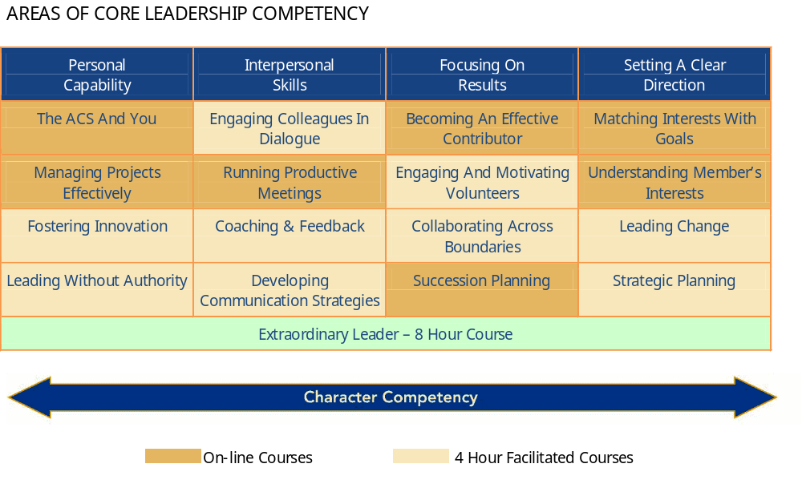
Connections in the
ACS Leadership Development System
Notes:
Your Society cares about your leadership capabilities – can be applied not only to ACS but other volunteer organizations, your workplace, and your personal interactions as well. Graphic shows core competencies, online and facilitated courses, and character competency is an overall goal.
Engaging and Motivating Volunteers is the core course recommended for all LS leaders, but if you’ve already taken it, then you have made other course choices.
Note the Strategic Planning workshop, bottom right of the graphic.

Slide 38
Planning Successful Activities
TH ANK YOU FOR YOUR PARTICIPATION!
WE HOPE YOU FOUND THIS WORKSHOP HELPFUL AND HAVE MADE SOME NEW CONNECTIONS.
Please have an enjoyable and productive experience
here at the 2017 ACS Leadership Institute!
Notes:
Summarize what we did; remind that this is all part of their opportunity to develop as strong leaders!
Each LS participant has signed up for two courses tomorrow.

