Slide 1
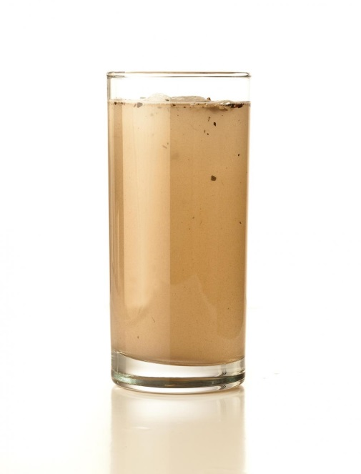
Out Dirt, Out Germs!
Materials
Dirty water (from a marsh, river or reservoir)
2 liter plastic bottle with a cap
Plastic bottle (with the bottom cut off)
Beaker
Alum
Droppers
Coffee filter
Rubber ring
Fine sand
Coarse sand
Pebbles
Procedure (Part 1)
1. Pour dirty water from a marsh, river or reservoir (or a sample of water you have prepared with water and dirt) into the 2-liter bottle with a cap. Note the appearance and smell of the water.
2. Put the bottle's cap on and shake it vigorously for 30 seconds. Continue to aerate the water: pour it out into another bottle or into the beaker and immediately repeat the process, pouring the water back and forth about ten times. Once you are done with the aeration, the gasses will have escaped (all of the bubbles should have disappeared by now).
3. Add two tablespoons of alum to the aerated water. Slowly stir the mixture for 5 minutes. Describe the appearance and smell of the water.
4. Let the water sit in its recipient. Observe it every 5 minutes, for a total of 20 minutes. Write down your observations: What does the water look like now?

Slide 2
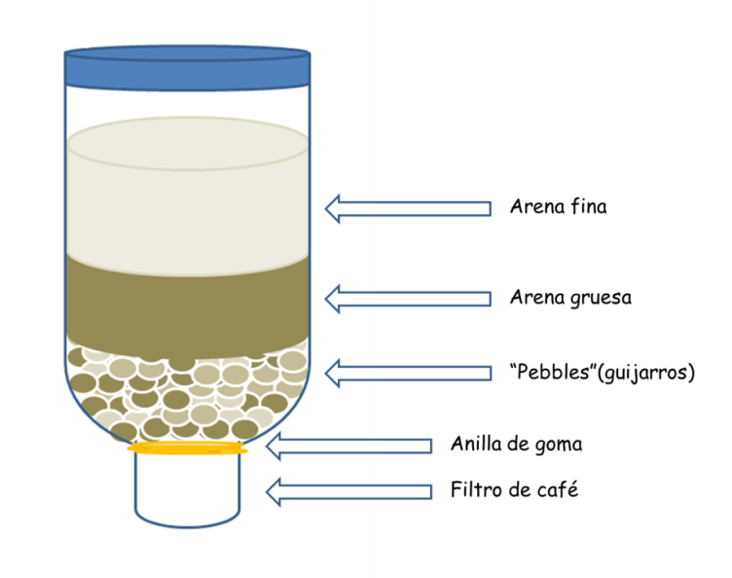
Out Dirt, Out Germs!
Procedure (Part 2)
5. Make a filter with the bottle with the cut-off bottom, by doing the following:
Place the coffee filter over the bottle's neck, attaching it with a rubber band. Turn the bottle upside down, and place it in the beaker or in the bottom of a 2-liter bottle with the bottom cut off. Place a layer of pebbles into the bottle; the filter will prevent them from falling out.
Place a layer of coarse sand on top of the fine sand.
Lastly, pour a layer of fine sand over the coarse sand.
Clean the filter by slowly and carefully passing clean drinking water through it. Throw out the water that has passed through the filter.
6. When there is enough sediment deposited on the bottom of the bottle filled with the water from a marsh, river or reservoir, pour out -without removing the sediment- the first two thirds of this water through the filter. Collect the filtered water in the beaker or plastic bottle.
7. Compare the treated water to the non-treated water. Have the water's appearance and smell changed after being treated?
water.chemistry2011.org/web/iyc

