Slide 1
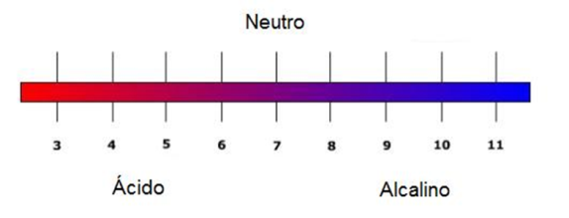
The pH of our Planet
Materials
Water samples (sea, river, lake, etc.)
Indicators
  obromothymol blue
  m-Cresol purple
6 cups (3 oz.)
Droppers
Procedure
Preparation of the indicators
Note: Bromothymol blue can be obtained in almost all of the stores that sell products for fresh water aquariums. m-Cresol purple is used for the samples of sea water.
Bromothymol blue
1. Dissolve 0.1 g of bromothymol blue in 16 mL of 0.01 M NaOH.
2. Once it is dissolved, slowly add 234 mL of water (distilled, if possible).
3. Store at room temperature
m-Cresol purple
1. Dissolve 0.1 g of m-cresol purple in 26 mL of 0.01 M NaOH.
2. Once it is dissolved, slowly add 224 mL of water (distilled, if possible).
3. Store at room temperature
Safety
The material used in this exercise is not dangerous as long as the solutions have been diluted following the procedures. Nevertheless, solid indicators may be irritants, particularly if ingested. They ought to be handled with care during their preparation, and you must wash your hands immediately after their handling.

Slide 2
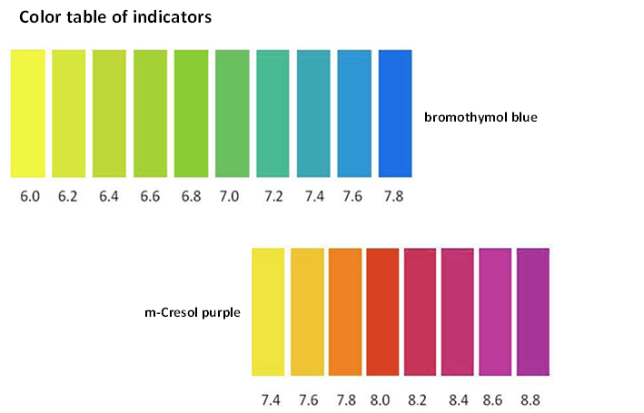
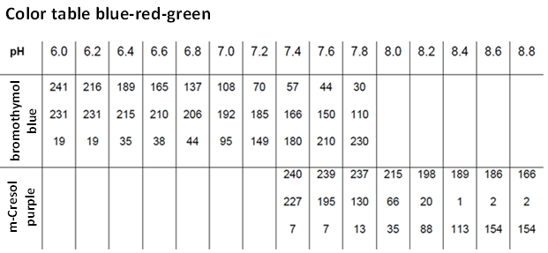
The pH of our Planet
Analysis of the local water sample
1. Label 6 cups from 1 to 6, marking each cup at the height of 0.5 cm.
2. Fill 3 of the cups up to the mark using the local water sample.
3. Add 3 drops of the bromothymol blue indicator to each cup, and stir well.
4. Use the color table to estimate the pH of each solution, and write down each cup's result, using a decimal.
5. If the sample's pH is 7.6 or greater, repeat the test 3 times, this time using the m-Cresol purple indicator and write down the results, using a decimal.
http://water.chemistry2011.org/web/iyc

