Slide 1
Cornstarch Putty: The liquid that wants to be a solid
Materials
½ cup plus 1 teaspoon of cornstarch
¼ cup of warm water
1 small cereal or dessert bowl (made of disposable plastic or ceramic)
Paper towels or newspapers
1 measuring teaspoon
¼ cup measuring cup
Procedure
1. Cover the work area with paper towels or newspapers. Put ½ cup of cornstarch in the bowl, add ¼ cup of water and mix it with your hands until it is mixed well.
2. Add 1 additional teaspoon of cornstarch and mix until it is soft again.
3. Use your fingers to grab a handful of putty. Describe what the putty is like as you scrape it. Hold it for a moment in the palm of your hand.
4. Put all of the putty back in the recipient and scrape it all together to form a large mass. Press on this with your finger. Do you make an indent in it easier when pressing hard or softly?
5. Take a little bit of putty and roll it between the palms of your hands in a circular motion. What happens as you move it? What happens when you stop? What happens to the putty when you slowly separate it and when you do it quickly? Quickly close your fist around the putty and then do so slowly. Describe the difference. When does it act like a liquid? When does it act like a solid?
You will make putty, a mysterious substance. You need to do some tests to decide if it is a solid or a liquid or both.

Slide 2
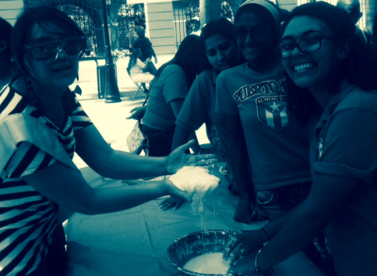
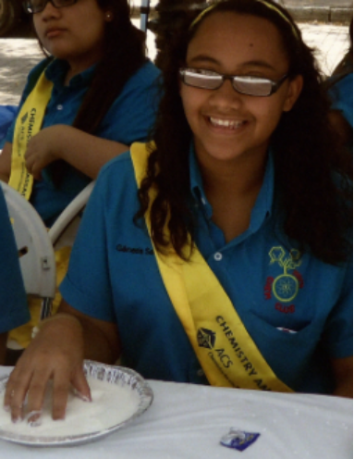
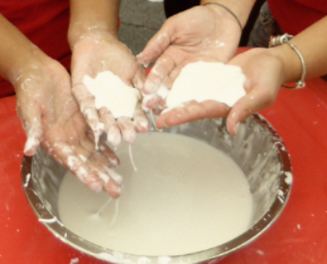
Cornstarch Putty: The liquid that wants to be a solid
Chemical explanation
Most scientists call this mixture a non-Newtonian liquid. It has some properties of a solid state and some of a liquid state, in addition to the unusual characteristic of being more of a solid when more pressure is exerted on it. That is why when you try and make it into a ball, it stays in a ball shape while it rolls, but when it stops it returns to a liquid state and drips over your hand. The nature of a non-Newtonian liquid is complex. It is an effect of water, which flows among the cornstarch molecules, which in turn push the liquid water out of the spaces and temporarily solidifies the substance. This effect is the same as that of quicksand, giving similar properties to the cornstarch putty.
Photo by Ingrid Montes, Puerto Rico 2014
Photo by Kelen Fureigh, Puerto Rico 2014
Photo by Kelen Fureigh, Puerto Rico 2014

