Slide 1
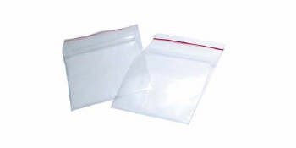
Interlacing a Polymer
Materials
A piece of a plastic bag that dissolves in water
A quart-size Ziploc bag
Water
Plastic cup
Sharpened pencil
2. Fill a glass with water. Place most of the PVA in the water. Leave a part of the PVA outside and hanging up over the edge of the glass so that you can later remove it.
3. Pour about 500 ml of water into a quart-sized Ziploc bag, so that a little less than half of the bag is filled with water. Seal it completely.
4. Lift up the bag so that everyone can see it. Then, poke the sharpened pencil through the bag, passing it through the water, so that it completely comes out the other side of the bag. Do not remove the pencil. Explain that the bag does a nice job holding the water because it forms a seal around the pencil.
Procedure
1. Show the students the piece of clear plastic polyvinyl acetate (PVA) and the piece of a Ziploc bag. Tell the students that this bag is made from a different polymer, low-density polyethylene (LDPE). Explain to them that both types of plastic are used to make clear plastic bags. Ask the students: What characteristics do these two types of plastic have in common?

Slide 2
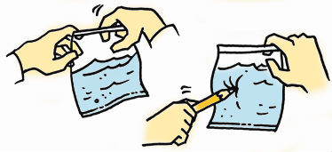
Interlacing a Polymer
Chemical explanation
Why does PVA dissolve in water while LDPE does not? The two pieces of plastic appear to be similar but are made from different polymers with different characteristics. Polyvinyl alcohol (PVA) is easily dissolved in water because its molecules are strongly attracted to water molecules. Low-density polyethylene (LDPE) does not dissolve in water because its molecules are not attracted to water.

