Slide 1


Can I Turn a Bottle Over without Spilling Water?
Materials
Water
3 medium-neck bottles
Netting or fabric with holes
Rubber bands
Card covered with translucent paper or placed inside a plastic bag
Demonstration preparation
1. Fill up the bottle with water.
2. Place the netting or fabric with holes over the mouth of the bottle and secure it with a rubber band.
3. Place the card over the mouth of the bottle.
4. Turn the bottle (filled with water) upside down, keeping the card over the bottle's mouth.
5. Slowly remove the card until the bottle is left uncovered.
6. The water should not spill.

Slide 2
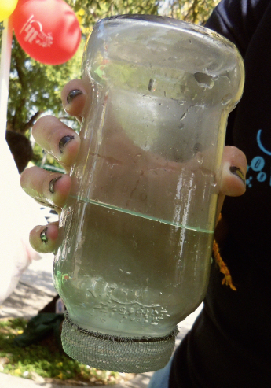
Can I Turn a Bottle Over without Spilling Water?
Say to the students:
Can scientists do magic tricks? What is really happening? Why doesn't the water spill?
Photo by Kelen Fureigh, Puerto Rico, 2014

