Slide 1

Plastics, Bioplastics and Recycling
By Ronald P. D’Amelia
In general, each period in history is known for the types of materials that people used to manage the world in which they lived. We had the Stone Age, the Iron Age and we are now in the Plastic Age. Plastics make up a large portion of automotive parts, construction materials, packaging materials, bottles, personal items and many other useful things. Except for our food, air and water, practically all everyday objects we come in contact with contain some type of plastic material. The word "plastic" comes from the Greek word "plastikos," which means "able to be molded or shaped." One of the advantages that plastic has over other materials is its durability. A great disadvantage of its durability is that plastic is unsafe for the environment. It tends to remain in landfills for a very long time before decomposing.
Basic Chemistry in Plastics
It is likely that there is no other man-made group of materials that is more important to our modern lifestyle than plastics. All plastics are made up of polymers. "Poli" means many and "mer" means parts or segments. Polymers make up most of our natural and synthetic world. Even we (human beings) are made up of polymers: Our hair, muscles, organs and DNA are all formed with polymers! Some examples of natural polymers are cotton, silk and wool. And some examples of synthetic polymers are milk cartons (made from polyethylene), nylon ropes (made from nylon polymer), drinking cups (made from polystyrene) and many other plastic items. Polymers are composed of repeating units that form a long a long chain-like structure. The repeating units are called monomers, which means "one." A sole polymer molecule is formed by a large number of monomers. The process in which monomers are combined is called polymerization. Given that polymers are very long and straight, like spaghetti, they can bend, twist and wrap around each other. They can even stick to each other! Polymers like plastics are better than metal because they are lightweight, not costly, easy to mold and hard to break. They last for a long time and some may be recycled.

Slide 2
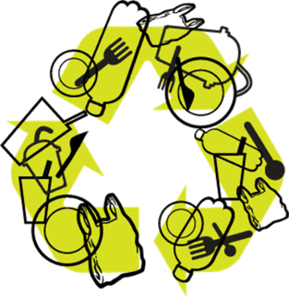
PLA: Biodegradable Plastic
By Ronald P. D’Amelia
Polylactic acid (PLA) is used in plastics and is renewable and biodegradable. PLA is made from starch, which is converted into sugar and then into lactic acid (monomers). The lactic acid monomers are joined together to form polylactic acid, a clear, stiff and glossy product. Common items that contain PLA include food packaging, disposable tableware and diapers. It also has many medical uses, such as in surgical suturing threads and devices that administer medication.
Biodegradable plastics, such as PLA, are safe for the environment because they dissolve or break down with heat, water, organic compost material and carbon dioxide (CO₂). Although PLAs are not ideal for the environment, they are a good start in creating plastics that are more environmentally friendly. In time, chemists will develop biodegradable plastics that have the look and functions of traditional plastic, without the hazardous effects on the environment. Listen to the ChemMatters podcast "Plastics-Go-Green" for more interesting information on how scientists are developing more environmentally-safe plastics.

