Slide 1
Communication, Collaboration & Contribution
Norah Xiao
University of Southern California Libraries

Slide 2
Overview
Background of USC and USC Libraries
Insight for the ACS Customer Advisory Panel
My insight for future of scientific publishing and communication

Slide 3
My Background
Science and Engineering Librarian
  Member of University Committee for Information Technologies appointed by the Provost and Academic Senators
Member of SLA – DCHE Advisory Board as SLA – ACS Liaison
Member of the education committee of ACS – CINF Division

Slide 4
University of Southern California (USC)
Research On The Cutting Edge
“nearly $560 million in annual research expenditures, and has ranked among the top 10 private universities in federal supported research activity”
http://www.usc.edu/research/about/

Slide 5
USC
Students (2009-10 academic year)
  Rounded to the nearest 500
  Undergraduates: 17,000
  Graduate and professional: 18,000
  Total: 35,000
International Students
  Rounded to the nearest 100
  Regularly Enrolled International Students: 6,600
  Optional Practical Training Students: 1,300
  Intensive English Language Students: 100

Slide 6
Key Changes & Initiatives
Within USC
  Senior administration changes
  Research initiatives: global research collaboration
  Education initiatives: “Urban Residential University”

Slide 7
Key Changes & Initiatives
Within USC Libraries:
  Implementation of the Strategic Plan
    Many library space renovation projects, e.g. the new first floor of the S&E Library
    Fundamental and on-going issues in the collection development
  Work on the next five-year strategic plan
    Reorganization
    Establishment of an academy of polymathic studies
Notes:
e.g. integrated library system (updated two versions, now we are using Sirsi symphony), correct records in the catalog, deal with the backlog of e-resources records, upload e-books to the Sirsi system
a new kind of interdisciplinary experience for our students and will focus on developing a serious facility for critical, multidisciplinary thinking

Slide 8
Within S&E Library: “Going Digital”
  More library spaces for collaborative learning
  More e-collections to support teaching, learning and research
    More e-books: Springer e-books collection from 2005 to 2010, and contract till 2012
    More backfiles: ACS symposium series
    More new databases: Reaxys, Conference proceedings citation indexes
    More new journals …

Slide 9
Within S&E Library: Challenges
  No budget cut but flat in past two years, might expect 6.5% cut in FY 2012
  Initiatives & services
    Institution repository
    Data curation and management for researchers (NIH and NSF requirements)
    Systematic information trainings for students e.g. courses embedded, or new courses designed

Slide 10
ACS and USC
most recent “ACS on Campus” at USC
  highlight ACS roles in chemistry researchers’ life
  education opportunity for users
  outreach opportunity for librarians to their users, and among librarians
  lessons learned
Notes:
Their primary professional association in their professional life, publishing is an integrated and important part of their professional growth.
They still don’t know what they don’t know, even all is in front of them.

Slide 11
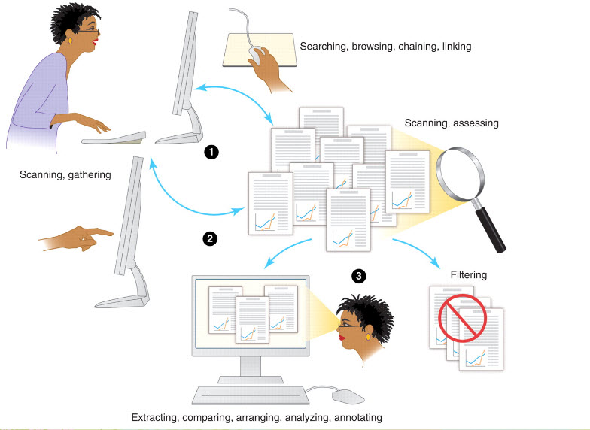
Scholarly Publishing & Scientific Research
Strategic Reading, Ontologies, and the Future of Scientific Publishing Allen H. Renear and Carole L. Palmer (14 August 2009) Science 325 (5942), 828. [DOI: 10.1126/science.1157784]

Slide 12
Customer Advisory Panel
Who are customers?
  Our researchers and students
What do they want?
  Current, complete, and current information
  Streamline information research within disciplines, inter- and multi-disciplines
  Rapid reading with more visualization aids and high-performance computing analysis
  Dissemination of information via global professional network

Slide 13
Customer Advisory Panel
Technology
  Go mobile
  Integration to SciFinder® auto search
Data & content
  Data preservation
  Author identification
Security
Specific issues
  Educational opportunities (business model)
Notes:
Iphone applications, search tab are
Educate students about their important society publication, from the day one
ACS style on-line version?

Slide 14
Best Practice & My Roles
Communication, communication and communication
Collaboration with information professionals, researchers and students
Contributions

Slide 15
Thank you!
Look forward to many great success together!
Contact information
  Email: nxiao@usc.edu
  Tel: 213-740-2214

