Slide 1
Bibliometrics: The State of Play June, 2011
Andrew White
Lutishoor Salisbury
Steve Hansen
Sara Rouhi

Slide 2
Agenda
Bibliometrics – A Review Article in PowerPoint
Today’s available metrics – review, what is used and what isn’t
Inside the Library – how Libraries use metrics to run their business
Best Practices – the best of the best in terms of reports, availability, delivery etc.
Limitations of today’s metrics
Wish list – what our Libraries could use to support higher-level-value

Slide 3
Metrics – What is Available Today
Top-Tier Metrics for Libraries
  Journal Impact Factor
  COUNTER usage
  Etc. etc.

Slide 4
Metrics – What is Available Today
Other available Metrics for Libraries
  ?
  Etc. etc.

Slide 5
Measuring Value of Scholarly Publications
Peer review
Citation index
Author reputation
Publisher reputation
Usage statistics
  Cost per use

Slide 6
Value Measured by Citability
ISI Impact Factor
  average number of citations to articles published in science and social science journals
SCImago Journal Rank
  number of citations received by a journal and the importance or prestige of the journals where such citations come from
Eigenfactor Score
  journals rated according to the number of incoming citations
Hirsch Index
  measure productivity and impact of a researcher through most cited papers and the number of citations that they have received in other people's publications
  Can be calculated with Google Scholar

Slide 7
Inside the Library
Use of Metrics – some examples for planning budgets and collections

Slide 8
COUNTER JR1 Report -- Number of Successful Full-Text Article Requests by Month and Journal
Journal | Jan | Feb | Mar | Apr | May | Jun
Academic Radiology | 0 | 0 | 0 | 4 | 4 | 1
ACC Current Journal Review | 0 | 0 | 41 | 0 | 0 | 0
Accident Analysis & Prevention | 8 | 2 | 3 | 12 | 5 | 0
Accident and Emergency Nursing | 0 | 2 | 1 | 1 | 3 | 0
Accounting, Management and Information Technologies | 0 | 0 | 0 | 0 | 0 | 0
Accounting, Organizations and Society | 0 | 0 | 0 | 1 | 0 | 0
Acta Materialia | 118 | 97 | 119 | 78 | 94 | 110
Acta Metallurgica | 0 | 0 | 0 | 0 | 0 | 0
Acta Metallurgica et Materialia | 0 | 0 | 0 | 0 | 0 | 0
Acta Oecologica | 3 | 13 | 28 | 1 | 1 | 0
Acta Psychologica | 4 | 6 | 1 | 7 | 9 | 0

Slide 9
Usage and visitors to the ten most frequently used full-text e-journal titles that are part of Medical Library virtual collection
Title | Total usage | Unique visitors
Nature | 9877 | 950
The Journal of Biological Chemistry | 7331 | 536
New England Journal of Medicine | 6795 | 1072
Cell | 6679 | 655
Proceedings of the National Academy of Sciences of the United States of America | 6144 | 633
Science | 5146 | 602
Biochemistry | 2860 | 286
Journal of Immunology | 2634 | 219
Journal of the American Medical Association | 2630 | 542
Lancet | 2547 | 454

Slide 10
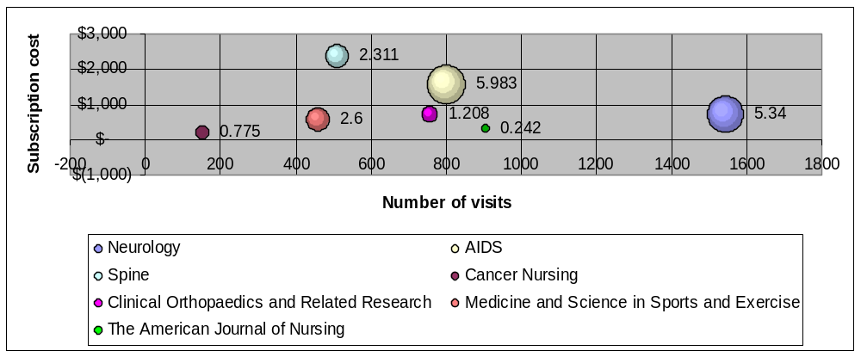
Does impact equate to local use?

Slide 11
Inside the Library
Use of Metrics – some examples for driving our business, enhancing the impact or added value of the library

Slide 12
Inside the Library
Use of Metrics – some examples for making decisions on new content – where historic metrics are not available

Slide 13
Inside the Library
Examples of a couple “Decision Matrices” from the real world?

Slide 14
Best Practices
Reports: These reports add value for the Library (and how)
  Ex…
  Ex…

Slide 15
Best Practices
Technology and/or implementation: These Websites, access tools, summaries etc. are ideal
  Ex…
  Ex…

Slide 16
Limitations…
Today’s bibliometrics present real limitations/challenges, because
  Metrics like Impact Factor are global. The journal may have low use/applicability at my specific campus, yet retains the high IF price
  COUNTER shows a download, not the ultimate fate of that information
  Metrics become a gate counter, and this results in…<negative consequences>

Slide 17
Wish list
ACS has the opportunity to improve the value-add for Libraries by
  Implementing these tools that are industry “Best Practices”. <Libraries need to confirm that this would add real value>
  Considering these new reports/capabilities that could stake out a Leadership position, and add real value for the Library

Slide 18
Conclusions
Anticipated state of metrics in 2-3 years
Summary of opportunities for ACS to play a constructive and positive role

Slide 19
Other questions – do we want to tackle these?
If not ROI, what? How do we all – Libraries, Publishers, Authors, Scientist readers – start to define “R” in a way tht’s meaningful?
How do e-Books fit into the metrics mix? Is a download a download?
Do bibliometrics serve other purposes – outside the Library even – that we should take into account?

