Slide 1

IT Security Report
James King (NIH), Norah Xiao (USC), Jonathan Morgan (ACS), Sara Rouhi (ACS)

Slide 2
Committee Charge
  Authentication and access best practices
  Short term (2-3 years) changes
  Customer ideal expectations
  Post-cancellation rights
Notes:
What are the industry best practices related to authentication and access?
What could change or dramatically affect these best practices in the next 2-3 years?
What are the customer ideal expectations when it comes to authentication, access, and abuse mitigation?
The team also added the issue of post-cancellation rights since it seemed interrelated to access issues.

Slide 3
Approach
  Literature Search
  Customer Focus Groups
  Publisher Survey
Notes:
What are the industry best practices related to authentication and access?
What could change or dramatically affect these best practices in the next 2-3 years?
What are the customer ideal expectations when it comes to authentication, access, and abuse mitigation?
The team also added the issue of post-cancellation rights since it seemed interrelated to access issues.

Slide 4
LITERATURE SEARCH

Slide 5
Literature Search
  Rovner, Sophie L., “A Question Of Identity” C&EN, May 24, 2010 http://pubs.acs.org/cen/science/88/8821sci2.html

Slide 6
FOCUS GROUPS

Slide 7
Focus Groups
  Sara is planning a round of customer focus groups and will include a question to librarians about their ideal expectations when it comes to authentication options and responding to online abuse detection.

Slide 8
PUBLISHER SURVEY

Slide 9
Publishers
    AAAS (Sara)
    AIP/APS (Norah)
    Elsevier (Norah)
    IEEE (James)
    Nature (James)
    OSA (James)
    PNAS (Sara)
    RSC (Norah)
    Springer (James)
    Wiley (James)
Notes:
AAAS (Sara)
AIP/APS (Norah)
Elsevier (Norah)
IEEE (James)
Nature (James)
OSA (James)
PNAS (Sara)
Royal Society of Chemistry (Norah)
Springer (James)
Wiley (James)
Note that Sara will be contacting another ACS CAP member to contact these publishers to reduce potential conflicts.

Slide 10
Publisher Survey
  What IP blocking techniques to you use?
  What authentication methods do you support?
  If a potential abuse is flagged, how do you respond?
  If a block is implemented, what is the process to restore access?
  How do you support non-IP based access?
  How are you supporting mobile device access to content?
  How are you supporting remote access to content?
  How do you handle post-cancellation rights?
  How has new technology like federated search and download harvesters affected your access blocking?
Notes:
What IP blocking techniques to you use?
Spider Traps: These are hidden links on some pages that a human being would never click on, but Web crawlers would follow when someone attempts to download large quantities of our content. The IP address of the user who hit the spider trap is blocked.
More than X downloads in a session: If more than X full-text HTML or PDF downloads occur in a single session, the IP address associated with that session is blocked.
More than X sessions in X minutes: This rule is intended to thwart abusers who have figured out the X download limit per session, and attempt to spawn multiple sessions to conduct a massive download.
Session duration longer than XXX minutes: It is intended to stop abusers who try to perform a massive download by throttling the downloads to a slower pace, but running for a long time.
What authentication methods do you support (IP authentication,OpenID, etc. – what other ones to add?)
If a potential abuse is flagged, how do you respond?
Notify primary POC
Block access to that address
Block access to entire domain
Throttle access down
Other
If a block is implemented, what is the process to restore access?
How do you support non-IP based access?
How are you supporting mobile device access to content?
How are you supporting remote access to content?
How do you handle post-cancellation rights?
Lose access to all online content
Provide a disk with subscribed content
Retain online access to specific years and titles subscribed during online subscription term
Retain online access to all titles from online subscription start date until cancellation date
Retain online access to all current and archival content up through last subscription year
How has new technology like federated search and download harvesters like Quosa and PubGet affect your access blocking?
We agreed that in return for a publisher sharing their information, we would provide a summary of the best practices we found. This summary will be reviewed and vetted by the team (and ACS) first.

Slide 11
Publisher Survey - Responses
AAAS - Waiting for answers
AIP/APS - Report received
Elsevier - Report received
IEEE - Awaiting decision
Nature - Not contacted
OSA – Report received
PNAS - wants mutual sharing
RSC - No
Springer - Awaiting decision
Wiley - Waiting for answers

Slide 12
Feedback - APS
  APS Feedback Summary

Slide 13
Feedback - Elsevier
  Elsevier Feedback Summary

Slide 14
Feedback - OSA
  OSA Feedback Summary

Slide 15
TRENDS

Slide 16
  Non-IP Authentication
    Cornell has developed and is starting to use ‘passkey’ (https://confluence.cornell.edu/display/CULLABS/Passkey+Bookmarklet)
  Mobile Impact

Slide 17
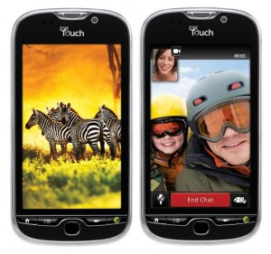
Notes:
The second opportunity is mobile technology.
This is my new smart phone, an Android My Touch. I previously had a Blackberry Bold and I must admit that this new device has dramatically changed my habits in a short period of time. Rather than simply viewing the handheld as an e-mail reader (which the Blackberry is great at), the Android is becoming my mobile computer and gateway to the cloud. Because of this device, I’ve now switched my master to do list for all parts of my life (work, home, church, SLA, etc.) to Toodledo – a web and mobile application to manage tasks. I’ve also switched personal notes, new photos and documents I’m working on to a secure file sharing service called DropBox. These cloud services are enhancing my mobile experience and encouraging me to use it more.
Just downloaded Google Docs app which can take a picture of a document and make it editable!
The NIH Library has made a strategic goal to build a mobile competency in the staff over the next couple years. This is being accomplished by providing mobile devices to the entire staff (some with phone service and others with just data plans), holding brown bag sessions to help each other learn new features, and hosting a Mobile Technology Expo earlier this month. We’re also using this initiative to make our own library Web site mobile-friendly and to build a collection of links to mobile versions of the journals and databases we provide. We feel that we need to first have a basic understanding of the technology and try to do our own job with a mobile device so that we can see the barriers that we’re imposing on using mobile with the library’s services. Why the big focus on mobile?

Slide 18
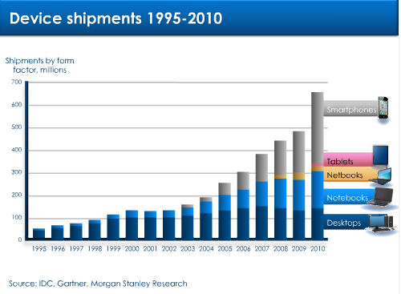
http://www.morganstanley.com/views/perspectives/tablets_demand.pdf
Notes:
As you can see from this chart, In 2010, over 80% of all shipping devices were mobile so the stationary desktop computer is quickly becoming a minority to its mobile cousins the netbook, notebook, table, and smartphone.

Slide 19
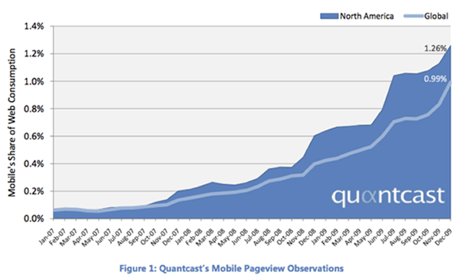
http://techcrunch.com/2010/01/05/quantcast-mobile-web-apple-android/
Notes:
Though this chart only shows from 2007-2009, you can see a dramatic growth in mobile web usage in that time. With the explosive growth of smartphone and tablets since then, I expect that the percentage will go higher quickly. In fact, many are predicting that mobile will be the primary access by 2020.
When I was at the Drupal conference earlier this year, the key developer told an audience of 3,000 that if they were building the massive open source content management system today rather than 10 years ago, it would have been a mobile-focused effort – a testament to where connectivity is heading in the near future.

