Slide 1







MOLE DAY: 10²³ 2021 CELEBRATION EVENT

Slide 2
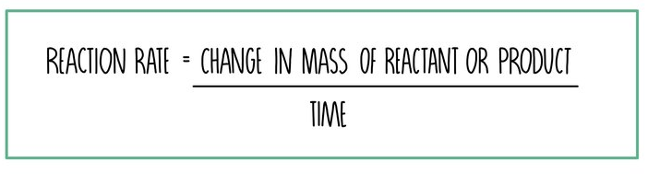
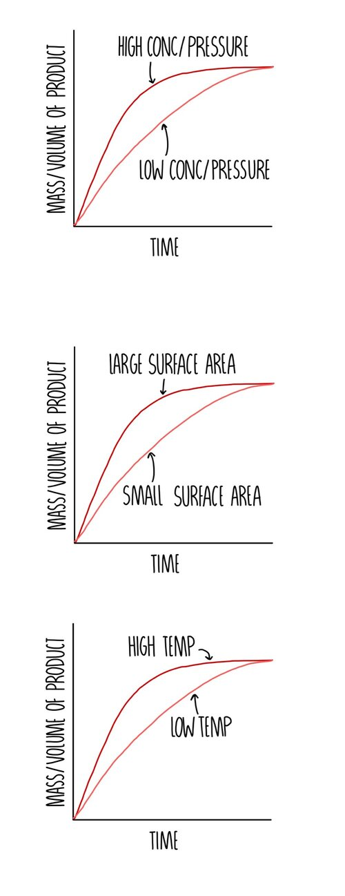
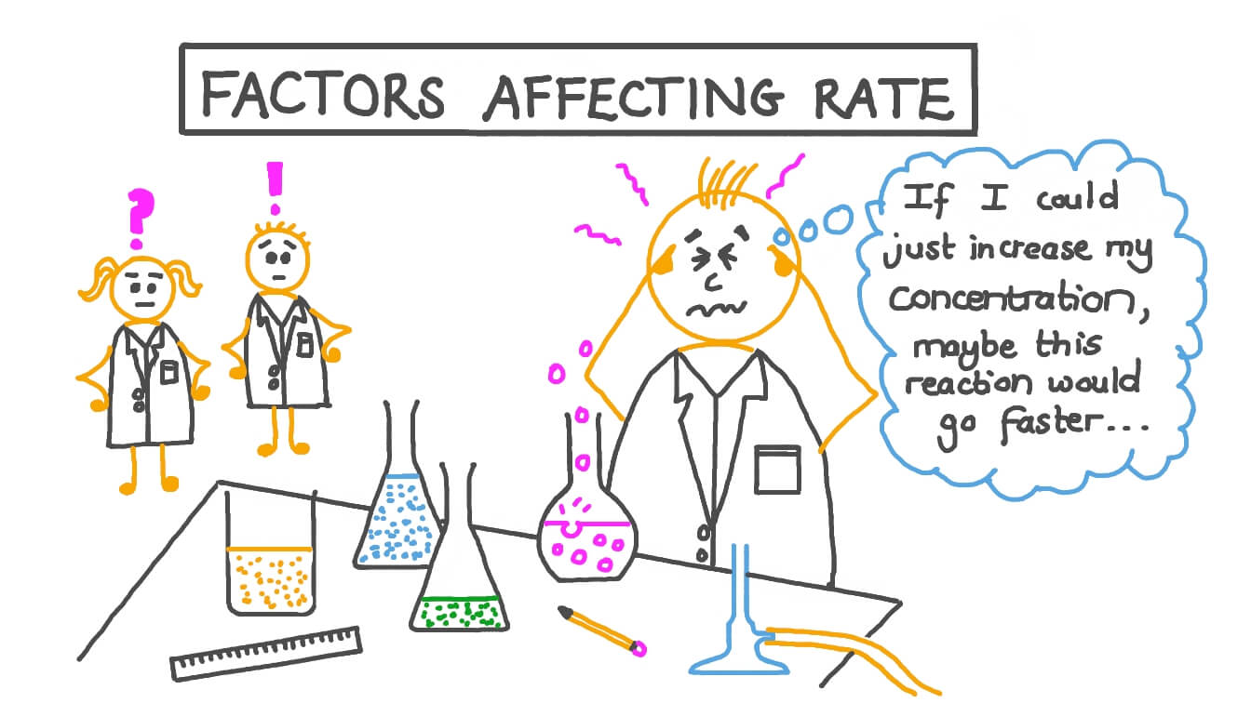
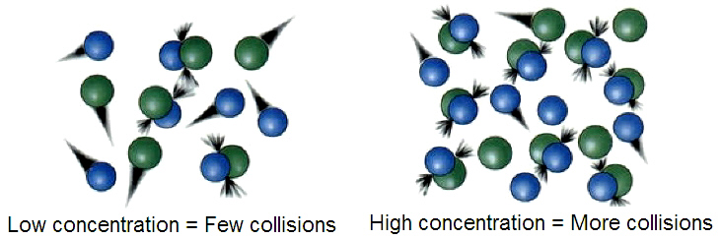
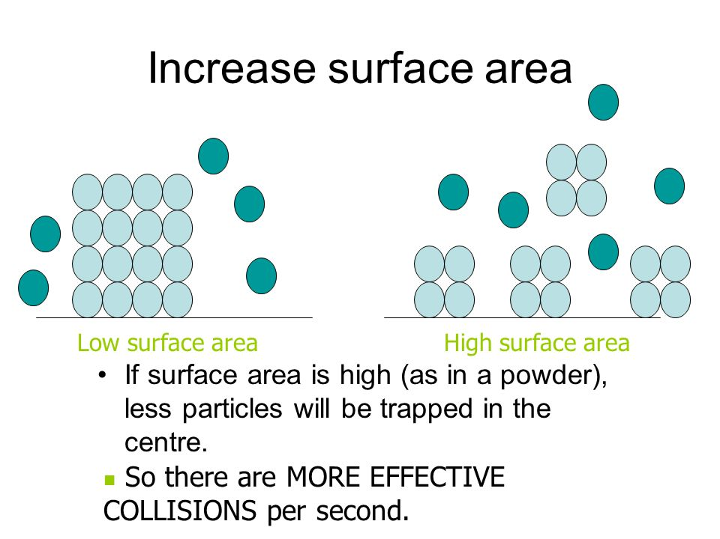
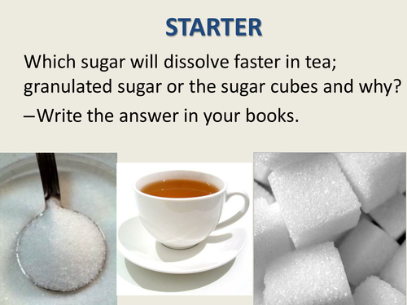
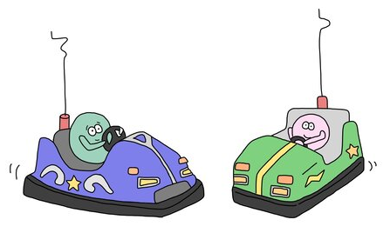
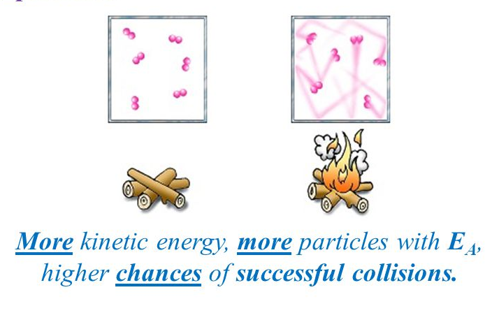

What controls chemical reaction rates?
Reactions require atomic or molecular collisions
Collision rate depends on concentration/pressure, surface area, temperature
To react, the collision must exceed the Activation Energy, E_{A}
EFFECT OF CONCENTRATION/PRESSURE
EFFECT OF SURFACE AREA
EFFECT OF TEMPERATURE

Slide 3
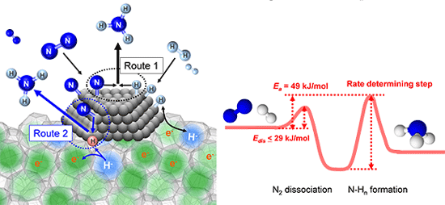
Important catalysts in Biology and Chemistry
Enzymes are nature’s catalysts and involve complex metal-organic structures. Because of their unique shape, these structures are highly selective for both reactants and products.
Industrial catalysts have been developed by chemists such as for the production of ammonia from nitrogen and hydrogen (Haber-Bosch Process)

Slide 4
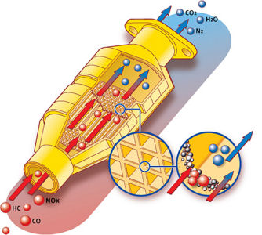
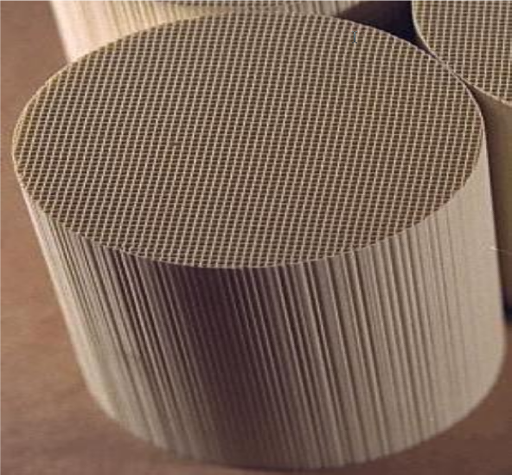
Catalytic converters clean your car’s exhaust
High temperature, low pressure gas phase reactions require high catalyst surface area
A Monolithic Cordierite Ceramic Honeycomb Structure provides a very high surface area support for the expensive noble metal catalyst

Slide 5
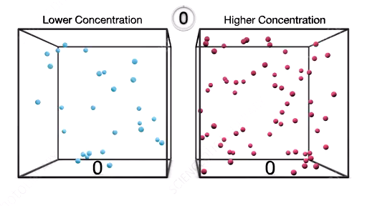
Effect of Concentration on Collision Rate

Slide 6
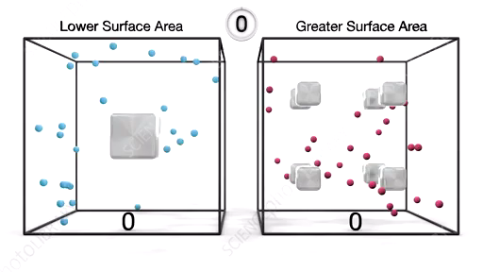
Effect of Surface Area on Collision Rate

Slide 7
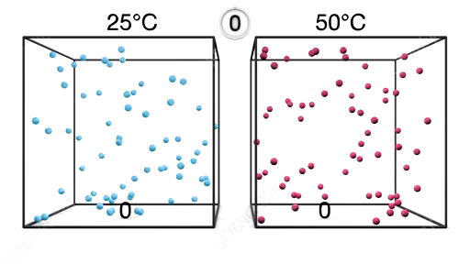
Effect of Temperature on Collision Rate

