Slide 1
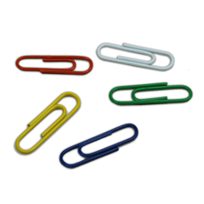
Water Walkers
Materials
Disposable aluminium pan for baking cookies and cakes
Water
Small paper clips
Pop-top rings, plastic labels
Aluminium foil or paper
Pencil
Scissors
Precaution
Do not drink any of the water samples used in this activity
5. Once you have practiced placing things on top of the water's surface, you are ready to create your own "water walker." Use the pencil to draw any type of animal you wish on the aluminum foil or paper, like you see in this picture. Make sure that your design has a flat surface that can float on the water -- and "big feet" work best!
6. Use the scissors to cut your design out.
7. Carefully place your design on the water and observe it. Does it float? If it does not float, try again, or make another "water walker" that you believe will work better.
8. Clean your work area thoroughly and wash your hands. Pour the water down the drain and throw out any trash.
Procedure
1. Fill up the pan with a few centimeters of water. Do not fill it up too much.
2. Hold a paper clip and watch what happens when you drop it into the water.
3. Now try to place a second paper clip on the surface, carefully laying it flat on top of the water's "skin" or surface. Try this until you can get the paper clip to float.
4. Try to make another paper clip or plastic label float on top of the water's surface. You will need practice and a steady hand.

Slide 2
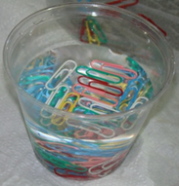
Water Walkers
Chemical explanation
As you learned in the "Testing the Water's Skin" activity, water molecules tend to attach to each other. This cohesion is strong enough on the water's surface to form a "skin." In this activity, you have to be very careful when placing the paper clip and other objects on the water's surface, so that you don't break the water's "skin." You must also lay them flat on the water, so that their weight is distributed over a large area. By spreading out the object's weight over a large area, it is able to float without breaking the water's "skin.“
Note: Once detergent is added to the pan, the water's "skin" will break. You will have to pour all of the water out and wash the pan well before continuing with your experiments.

