Slide 1

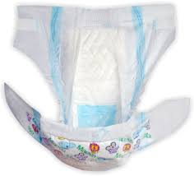

The Secret Science of Diapers
Materials
• Sodium polyacrylate
• Water
• 3 opaque plastic cups
• 3 clear plastic cups
4. In front of the students, put three teaspoons of sodium polyacrylate in a clear plastic cup.
5. Place this cup next to two other identical empty cups, all in a row.
6. Pour 30 ml of water into a beaker. Then, pour this water into the cup with the sodium polyacrylate.
7. Move the cups around like you did in the demonstration.
Procedure
1. Pour 30 ml of water into the cup with the sodium polyacrylate. Tell students that you will move the cups around and that they will have to tell you which cup has water in it.
2. Move two of the cups, so that they swap places. Repeat the same procedure with different cups, 3 to 5 times.
3. Ask the students: Which glass contains the water? When they choose a cup, turn it over. It does not matter which cup they choose, the water will not spill! Ask the students to choose another cup and hold the cup upside down. Lastly, turn the last cup over.

Slide 2
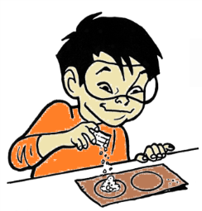
The Secret Science of Diapers
Chemical explanation
Sodium polyacrylate absorbs water well due to its shape and the intense way it attracts water.
Like all polymers, sodium polyacrylate is made up of long molecules. Long molecules contain repeated combinations of the same atoms, making the polymer a chain with many similar links. When dry, sodium polyacrylate molecules have a spiral form. When water is added, the long chains stretch and harden, exposing even more areas to attract water.
Water molecules can also fit between the sodium polyacrylate molecules because they can simultaneously attract two polymer chains. This attraction connects independent polymer chains. When enough water molecules connect separate polymer chains, a layer of water forms between the sodium polyacrylate molecules.
Having many areas that attract water and being able to trap it between the polymer chains makes sodium polyacrylate very absorbent.

