Slide 1
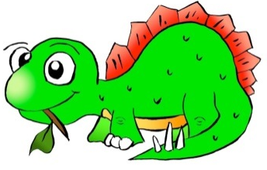


How much can a toy dinosaur grow?
Materials
Toy dinosaur that absorbs water
Water
Beaker
Ziploc bag
Metric ruler
Two days later
Leave the sealed dinosaur inside the bag and place it on the ruler. Measure the distance from its tail to its nose, to the nearest millimeter. How long is your dinosaur?
Expected results
In a few days, the dinosaur will grow to almost six (6) times its original size. There will also be about half the amount of water left unabsorbed in the bag.
Procedure
1. Place the dinosaur on the ruler so that its tail is on the line marked with zero and its nose is on the millimeter lines. Measure it, to the nearest millimeter.
2. Use your beaker to measure 90 ml of water. Pour the water into the Ziploc bag.
3. Place the dinosaur into the water, get out as much air as possible and carefully seal the bag.

Slide 2

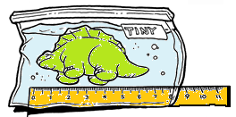
How much can a toy dinosaur grow?
Chemical explanation
These water-absorbing dinosaurs are made from two polymers: a super absorbent polymer called polyacrylamide and another polymer called cellulose, like the one used in sponges. The water is absorbed well because the polyacrylamide molecules are strongly attracted to the water molecules. Cellulose is also attracted to water, but it is mainly used to help keep the dinosaur's shape, as it grows to accommodate more and more water.

