Slide 1
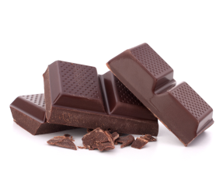
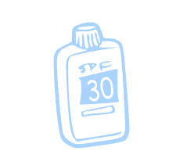
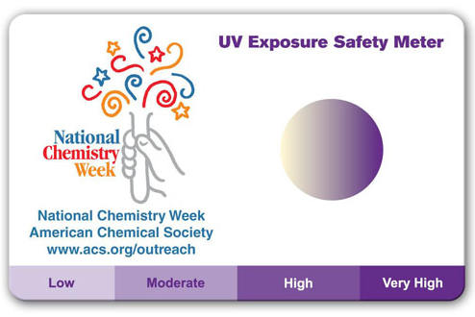
Safely Under the Sun
Materials
A card with a photochromic ultraviolet light sensor (PULS) or another indicator card, or UV detection beads
One letter-sized envelope
One Ziploc bag (snack size)
A watch with second hand
A clear sunscreen spray with SPF 30 or higher
Paper towels
Chemical explanation
Sunscreen protects our skin from ultraviolet rays. We can get an idea of how well a sunscreen will work based on its SPF. The higher the SPF, the stronger the sunscreen. The American Academy of Dermatology recommends using sunscreen with an SPF of 15 or higher anytime you go to work or play outside.

Slide 2
Safely Under the Sun
Procedure
1. Before going out, place the PULS card in an envelope so that it does not come in to contact with the sunlight.
2. Look for a sunny spot where you can place your card. Avoid the shadows of buildings and trees.
3. Using terms like "partially cloudy," "rainy," or "sunny," describe the weather in that area. What did you observe?
4. Remove the PULS card from the envelope and place it in a Ziploc bag.
5. Hold the bag with the card inside, pointing it toward the sun for around 20 seconds.
6. Closely observe the portion of the card that changes color and compare it to the "Level of sun exposure" section. Choose the saturated color from the scale that is closest to the portion of the card that changed color. Read the word that is written below that saturated color (minimum, low, moderate, high or critical) and write it down in the "What did you observe?" section.
7. Remove the card from the plastic bag and put it back into the envelope so that it is out of the sunlight for at least 3 minutes.
8. While you wait, spray the outside of the bag with sunscreen. Be careful to spray it in an even coating. If the sunscreen does not form an even and transparent coating, remove any excess with a paper towel.
9. Write down the SPF grade of the sunscreen in the "What did you observe?" section.
10. After 3 minutes, open the plastic bag and place the PULS card inside.
11. Repeat Steps 5 & 6, writing down the results in the "What did you observe?" section.
12. Discard the plastic bag in the garbage can, but save the card and sunscreen for future use. Thoroughly clean your work area and wash your hands.

