Slide 1
PEVOP Update
American Chemical Society
PEVOP Subcommittee
Society Committee on Budget and Finance
5/14/2020

Slide 2
Executive Summary
Committee Responsibility
Participate in SPPM: A holistic process designed to transparently manage the strategic addition, ongoing review and potential sun setting of programs within Membership & Society Services, Scientific Advancement, Education and the Office of External Affairs and Communications.
PEVOP
Responsibility
Develop a revised SPPM process, which will focus on a strategic view of the portfolio of programs that are mapped to the Society’s strategic goals in conjunction with Society Program EVPs, Society Leadership and staff.
Revised SPPM Project Goals
Focus on portfolio-level strategic/ financial discussions
Optimize Current SPPM Process
Collaborate with the right stakeholders at the right times
Build a strategic, efficient, streamlined, impactful SPPM encompassing, collaborative process
See Bylaw III, Sec. 3, e(1)(a) iv, v, vi
Notes:
Purpose:
Executive level summary highlights the high level responsibilities and Revised SPPM Project Goals.

Slide 3
Working Group Updates

Slide 4
Working Group I
 | Work Group and Initiative | Outcomes | Outputs
WG I | Strategic Mapping Define Strategic Assessment Tools Contemplate Program Coverage, Redundancies, Sunset, Expansions | Agreement on QUAD Chart criteria Agreement on evaluation tools Agreement on evaluation process Consider UN Sustainable goals v. Gaps | Defined criteria & assessment mechanisms Defined evaluation & feedback process
Update:
  Paul + PM/Staff Organization/Informational meetings
Critical Task(s):
  Routine meetings being organized
  Strawman Objectives and future state in progress
  Team familiarization with Strawman via email
Risks/Resources:
  Risks: Failure to conceive at a strategic, efficient, impactful level
  Resource Needs: None
WG I
Paul Jagodzinski
Carol Duane
Natalie LaFranzo
Marinda Wu
Notes:
Purpose:
This slide is the one slider report up to PEVOP Leadership capturing the scope, critical next task(s) and any communication needed
Process:
Collaborative effort by working group leader and project manager

Slide 5
Working Group II
 | Work Group and Initiative | Outcomes | Outputs
WG II | Interactions & Flow of Information among & between stakeholders Define Stakeholder Interactions Determine 2021 Sequencing Develop Communication Plan | Detail elements of SPPM Process Agreement on customer management process Understanding of how reimagined SPPM elements aligns with timeline of ACS strategic planning and budgeting decisions | Improved SPPM Process SPPM Process timeline (including review of EVP recommendations, submission, review, new programs, pilot periods, feedback schedule) Written communications (e.g., notices, announcements, reports)
Update:
  Located preliminary list of stakeholders as defined in the SPPM Reimagination Workshop in November (credit to Ralph Domenick)
  Draft layout of stakeholder hierarchy circulated to WG II members.
Critical Task(s):
  Determine frequency (cadence) of reviews
Risks/Resources:
  Risks: None
  Resource Needs: None
WG II
Bryan Balazs
Chris Bodurow
Peter Dorhout
Bill Greenlee
Notes:
Purpose:
This slide is the one slider report up to PEVOP Leadership capturing the scope, critical next task(s) and any communication needed
Process:
Collaborative effort by working group leader and Tiffany

Slide 6
Working Group III
 | Work Group and Initiative | Outcomes | Outputs
WG III | Program Funding Requests Process 2020 Funding Requests and Reauthorizations | Standardize/Normalize Program Funding Assessment & Reporting Processes Consider interfaces with other SPPM features to strengthen the PF process | Defined roles and responsibilities in PF Process Communicate Program Funding Process and tools consistently to a broader audience (e.g., staff, Cog. Comm., new idea generators, etc.) 2021 Integration into SPPM process
Update:
  Proposed revised New concept process was discussed – recommendations made by WGIII
  Identified issues with reauthorization process/form and discussed potential solutions– recommendations forthcoming
Critical Task(s):
  Evaluate new program funding requests/reauthorizations for 2020 – End of May through June - Willem
  Re-envision the current new program funding process, identify the issues and design a process that solves them – Starting now until August - Dana
Risks/Resources:
  Risks: None
  Resource Needs: None
WG III
Dana Ferraris
Willem Leenstra
Bonnie Lawlor
Diane Schmidt
Notes:
Purpose:
This slide is the one slider report up to PEVOP Leadership capturing the scope, critical next task(s) and any communication needed
Process:
Collaborative effort by working group leader and Tiffany

Slide 7
Reference Material

Slide 8
Current State Process Map

Slide 9
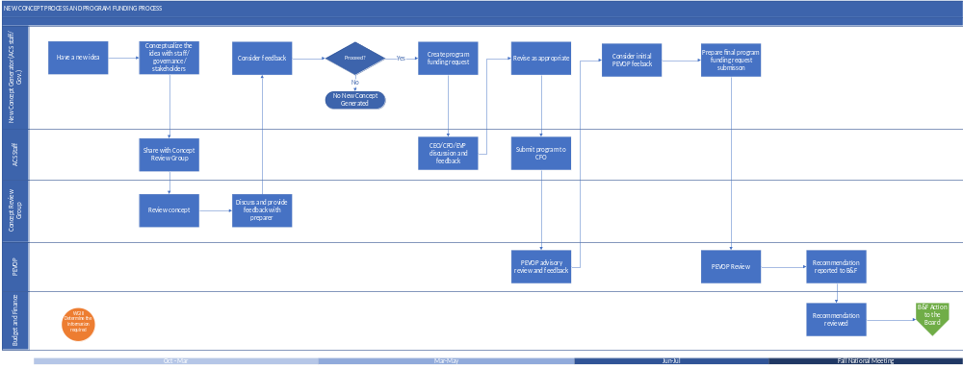
New Concept Process and Program Funding Request
DRAFT

Slide 10
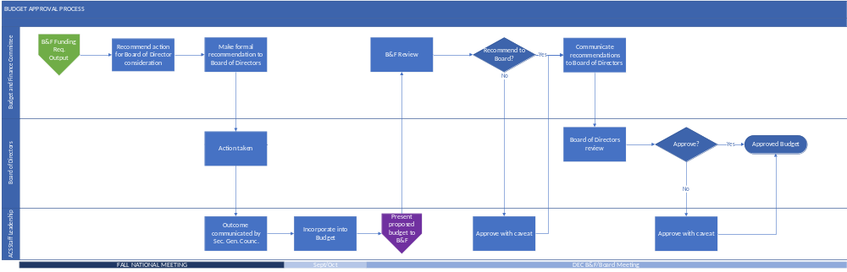
Budget Approval Process
DRAFT

Slide 11
Possible Future State Process Map
~A Starting Point~

Slide 12
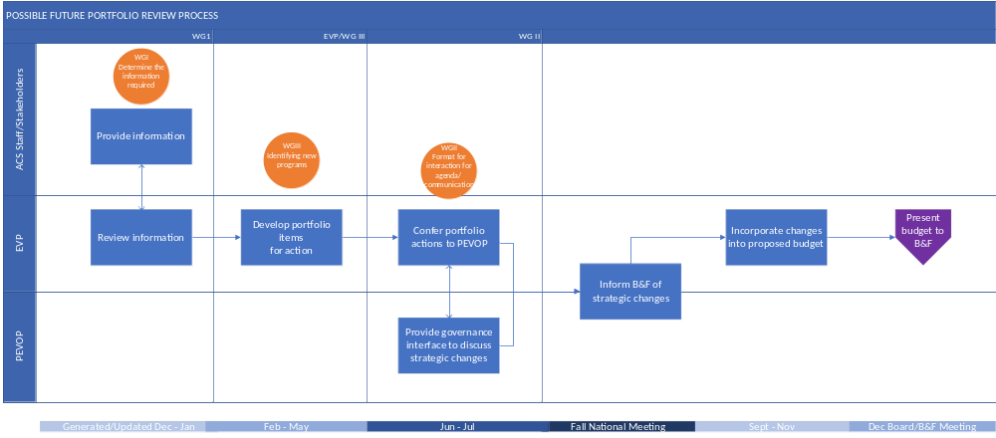
Possible Future Portfolio Review Process
DRAFT

Slide 13
Update as needed
DRAFT
5/14/2020
5/28/2020
Acronyms
Apr 1 - Aug 14
Aug 14 - Nov 14
6/11/2020
6/25/2020
6/25/2020
7/9/2020
EVP – Society Program Executive Vice Presidents
PEVOP – Subcommittee on Portfolio Evaluation and Optimization
PFR – Program Funding Request
PFRS – Subcommittee on Program Funding Requests (moved into PEVOP 2020)
PM – Project manager/project management
PR – Program Review
PRS – Subcommittee on Program Review (moved into PEVOP 2020)
RACI - Responsibility assignment matrix (Responsible | Accountable | Consult | Inform)
SPPM – Society Program Portfolio Management Process
7/9/2020
7/23/2020
7/23/2020
8/6/2020
8/4/2020
8/14/2020
8/14/2020
8/27/2020
8/27/2020
9/3/2020
9/3/2020
9/17/2020
9/17/2020
10/1/2020
10/1/2020
10/15/2020
2020
10/15/2020
10/30/2020
10/30/2020
11/14/2020
Notes:
Purpose:
Acronym reference documentation

Slide 14
Project Structure
DRAFT
Board of Directors
ACS Leadership
Subcommittee Leadership
B&F Leadership
PEVOP Leadership
Al
Horvath
Ralph Domenick
B&F Chair
Bill Greenlee
Willem Leenstra
Carol Duane
Tiffany Hoerter
WG I
Paul Jagodzinski
WG II
Bryan Balazs
WG III
Dana Ferraris
EVP
Work Groups
Carol Duane
Natalie LaFranzo
Marinda Wu
Bill Greenlee
Chris Bodurow
Peter Dorhout
Willem Leenstra
Diane Schmidt
Bonnie Lawlor
Flint Lewis
Kate Fryer
Mary Kirchhoff
LaTrease Garrison
Notes:
Purpose:
The project structure shows the integration of teams into broader leadership and society for reference

Slide 15
Project Communication Plan
DRAFT – Tiffany to work with Leadership/WG/Ralph to adjust
DRAFT
PEVOP Leadership
Project Manager
Working Group Leaders
Working Groups
B&F Leadership
ACS Leadership
Clearly defined communication
Group | Type | Frequency | Owner
ACS Leadership | High level summary | Aug/Dec (Quarterly) | Bill Greenlee
B&F Leadership | Detailed Summary | Aug/Dec | Willem Leenstra Carol Duane
PEVOP Leadership | Working Group Summary | Semi-monthly per schedule | Project Manager/ Work Group Leaders
Project Manager | Working Group: -Scope -Deliverables -Timelines -Resource needs | Determined by PM and working group leader. No less than semi-mon. | Working Group leaders
Working Group Leader | Strategy/high level task info | Determined by Working group and working group leader no less than semi-mon. | Project Team members
Working Group | Detailed strategy and task level info | Determined by Working group and working group leader no less than semi-mon. | Free communication within team and as defined working group leaders. Provide details as req.
Notes:
Purpose:
This documents how standard communication will flow between working group and the various levels of leadership.
Clear communication through out the project structure is critical to success.
Aligned communication across group boundaries is also critical to decrease project churn (delays)
Process:
Tiffany to work with leadership/working groups and Ralph to adjust
Definitions:
Project Manager: Tiffany Hoerter

