Slide 1
Bibliometric applications in libraries: an overview
June, 2011
Steve Hansen , Sara Rouhi, Lutishoor Salisbury , and Andrew White

Slide 2
Metrics in Use -- ISI Journal Citation Reports
ISI Journal Citation Reports -- provides journal impact factor, 5-year journal impact factor, journal immediacy Index and Journal Cited Half-Life.
Journal Impact Factor
To calculate, divide citations to articles from the most recent two full years by the total number of articles from the most recent two full years. This answers: how much is this journal being cited during the most recent two full years?
5-Year Journal Impact Factor
To calculate, divide citations to articles from the most recent five full years by the total number of articles from the most recent five full years. This answers: how much is this journal being cited during the most recent five full years?

Slide 3
Metrics in Use - ISI Journal Citation Reports
Journal Immediacy Index
This is calculated by dividing the citations to articles from the current year by the total number of articles from the current year. This answers: how is this journal being cited during the current year?
Journal Cited Half-Life
For the current Journal Citation Reports year, the median age of journal articles cited. This answers: what is the duration of citation to articles in this Journal?

Slide 4
JCR -- Strengths
Global view of internationally influential journal
Simple calculation to understand
Does not reward journals because of longevity, published many papers or are issued frequently
Gives insight into recent performance
Produced for a long time, view changes of a journal through time
Ref: Pendlebury, David A. 2009. Use and misuse of journal metrics and other indicators. Arch Immunol. Ther. Exp. Vol. 57, p3

Slide 5
JCR Limitations
Too simple a measure – does not capture enough of the multidimensional phenomena of a journal’s influence
There is confusion over the definition of citable items
The impact factor is a ratio that is the mean of skewed distribution
Review journals often have high impact factors
Differing absolute impact factor from one field to another makes cross-field comparisons difficult or meaningless
Two year citation data too short for some fields
Matching citation counts to journal titles can be problematic
Multidisciplinary journals – mixed set of papers
Subject field definition is murky
Not useful for the humanities
Ref: Pendlebury, David A. 2009. Use and misuse of journal metrics and other indicators. Arch Immunol. Ther. Exp. Vol. 57, p3
Notes:
Too simple a measure that does not capture enough of the multidimensional phenomena of a journal’s influence
Concern over the definition of citable items
The impact factor is a ratio that is the mean of skewed distribution. The familiar 80/20 rule, meaning that a small portion of the population of papers accounts for a very large portion of the influence, in this case citations. It is thus misleading concerning central tendency
Review journals often have high impact factors and thus have an advantage over non-review journals
Differing absolute impact factor from one field to another makes cross-field comparisons difficult or meaningless
Two year citation data too short for some fields such as mathematics
Matching citation counts to journal titles can be problematic.
Multidisciplinary journals – mixed set of papers in terms of fields, produce mixed impact factor which is of little use
If a journal is not indexed in ISI, there is no impact factor
Coverage biased against certain nations and English language journals. Hence they reward some journals and hurt others.

Slide 6
Eigenfactor
Eigenfactor (http://www.eigenfactor.org/). Data supplied for this metric by Thomson Reuters (ISI) -- provides Eigenfactor for journals and article influence for each article in a journal.
The Eigenfactor score and the Article Influence score is calculated based on the citations received over a five year period

Slide 7
A journal's Eigenfactor score is a measure of the journal's total importance to the scientific community. With all else equal, a journal's Eigenfactor score doubles when it doubles in size.
Thus a very large journal such as the Journal of Biological Chemistry which publishes more than 6,000 articles annually, will have extremely high Eigenfactor scores simply based upon its size.

Slide 8
Article Influence score measures the average influence, per article, of the papers in a journal. As such, it is comparable to Thomson Scientific's widely-used Impact Factor. Article Influence scores are normalized so that the mean article in the entire Thomson Journal Citation Reports (JCR) database has an article influence of 1.00.

Slide 9
Scopus Journal Analyzer
It allows searching the entire collection of journals covered by Scopus along with their SNIP and SJR metrics going back to 1999.
Source Normalized Impact per Paper (SNIP) measures contextual citation impact by weighting citations based on the total number of citations in a subject field. The impact of a single citation is given higher value in subject areas where citations are less likely, and vice versa.
SCImago Journal Rank (SJR) -- metric based on the idea that all citations are not created equal’ With SJR, the subject field, quality and reputation of the journal has a direct effect on the value of a citation.
Notes:
It is important to recognize that all these measures and several others are used to answer different questions and each will emphasize certain aspects.
Many of these measures are used in evaluation of research productivity

Slide 10
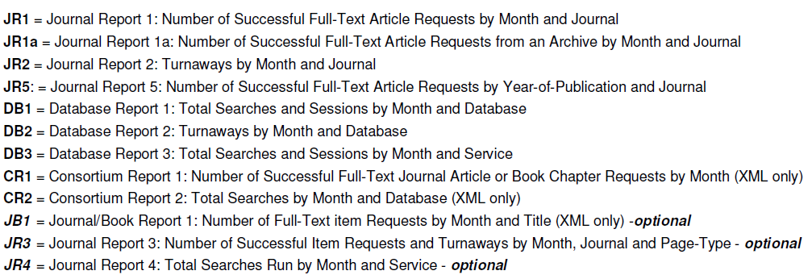
Counter Measures

Slide 11
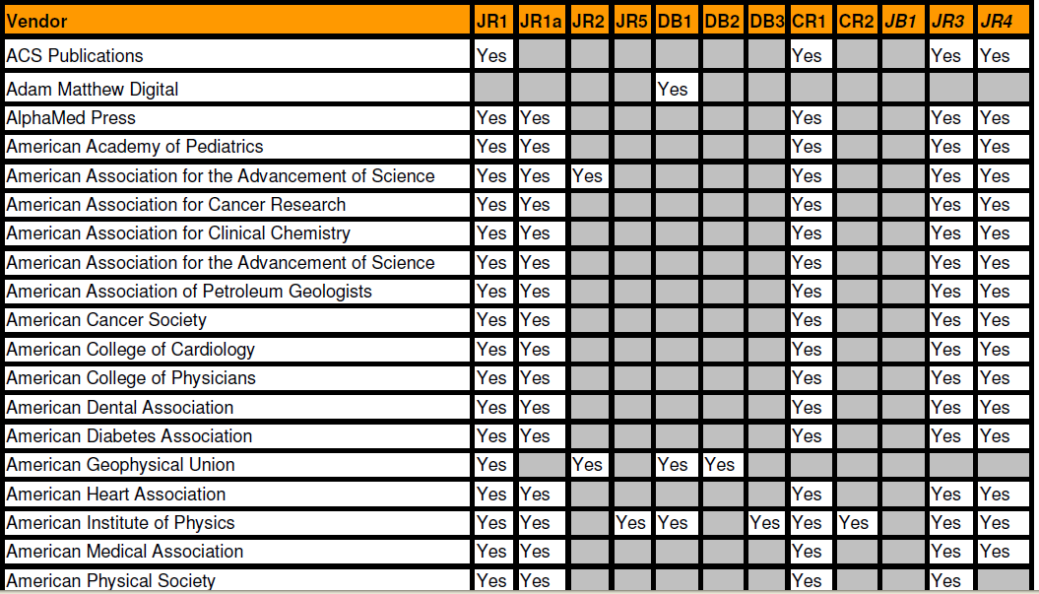
How ACS Compares Against Other Vendors

Slide 12
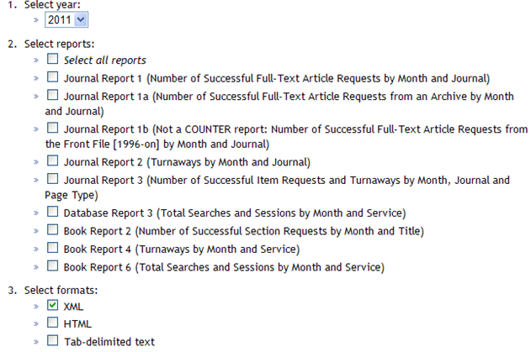
ACS Data Available to aid Decisions

Slide 13
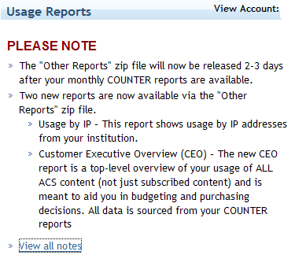
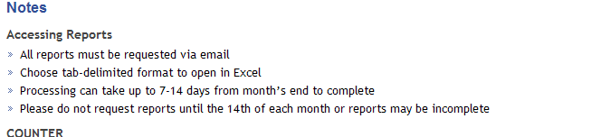
Other Reports to Aid Collection Decisions

Slide 14
How ACS Compares

Slide 15
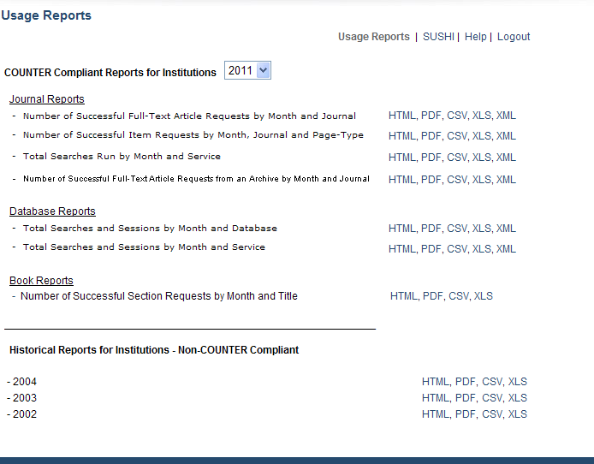
AIP Statistics
Almost same information -- Do not have to request

Slide 16
What is Lacking from Counter to Aid Collection Decision
Data supplied is an overview of the journal and its use by month/year/type of page
How many articles are in the journal issue and how many was used/downloaded?
What specific articles are used?
How many times a particular hot article was accessed from a journal?
Are a few articles contributing to high use of a journal continuously?

Slide 17
Measuring Value of Scholarly Publications
Peer review
Citation index
Author reputation
Publisher reputation
Usage statistics
  Cost per use

Slide 18
Does impact equate to local use?

Slide 19
How libraries use metrics:
No one single approach is used to make decisions!!
Online Usage data
In house use data
Citation data (faculty and journals)
Interlibrary Loan
Faculty perception of usefulness
Top journals in the field
Strength and focus of program
Librarian’s assessment

Slide 20
Examples of Using Metrics for E-Journal Selections
Luti will be working on these soon

Slide 23
Stony Brook U. Health Sciences
Title | Impact Factor 2004 from JCR | Format | Latest Payment Cost | Cost per Use | 2005 Visits | 2005 Unique_Visitors | Rank out of 3460 used e-resources | Subject headings
Acta Neuropathologica | 2.503 | 2 | 5,375.00 | 67.19 | 80 | 24 | 634 | Histological Techniques -- periodicals.####Histological Techniques -- electronic journals####Neurology -- periodicals####Neurology -- electronic journals####Nervous System Diseases -- periodicals####Nervous System Diseases -- electronic journals####Pathol
Acta Odontologica Scandinavica | 0.884 | 3 | 379.00 | 22.29 | 17 | 9 | 1765 | Dentistry -- periodicals####Dentistry -- electronic journals##
Administration in Social Work | 0.179 | 3 | 573.68 | 33.75 | 17 | 12 | 1778 | Social Work -- organization & administration -- periodicals.##
Aids Research and Human Retroviruses | 2.375 | 2 | 2,185.26 | 49.67 | 44 | 27 | 1046 | Acquired Immunodeficiency Syndrome -- periodicals.####Retroviridae -- periodicals.####Sexually Transmitted Diseases -- periodicals##
Alcohol research & health | 0.918 | 3 | 26.32 | 5.26 | 5 | 5 | 2583 | Alcoholism -- periodicals.####Alcoholism -- electronic journals####Alcoholism -- therapy -- periodicals.####Alcoholism -- therapy -- electronic journals####Alcoholism -- prevention & control -- periodicals.####Alcoholism -- prevention & control -- elctron
Alcoholism Treatment Quarterly | 0.000 | 3 | 585.00 | 58.50 | 10 | 8 | 2148 | Alcoholism -- therapy -- periodicals.####Social Work -- periodicals##
American Journal of Community Psychology | 0.938 | 2 | 1,029.47 | 35.50 | 29 | 19 | 1394 | Community Mental Health Services -- periodicals.####Community Mental Health Services -- electronic journals####Psychiatry -- periodicals####Psychiatry -- electronic journals####Psychology -- periodicals####Psychology -- electronic journals##
American Journal of Nephrology | 1.342 | 2 | 1,863.00 | 60.10 | 31 | 20 | 1313 | Nephrology -- periodicals.##
American Journal of Reproductive Immunology | 1.808 | 2 | 1,139.00 | 87.62 | 13 | 7 | 1940 | Allergy and Immunology -- periodicals.####Reproduction -- periodicals.##

Slide 24
How libraries use data
Not one single approach is used to make decisions

Slide 25
Agenda
Bibliometrics
Today’s available metrics – review, what is used and what isn’t
Inside the Library – how Libraries use metrics to run their business
Best Practices – the best of the best in terms of reports, availability, delivery etc.
Limitations of today’s metrics
Wish list – what our Libraries could use to support higher-level-value

Slide 26
Metrics – What is Available Today
Top-Tier Metrics for Libraries
  Journal Impact Factor
  COUNTER usage
  Etc. etc.

Slide 27
Metrics – What is Available Today
Other available Metrics for Libraries
  ?
  Etc. etc.

Slide 28
Inside the Library
Use of Metrics – some examples for planning budgets and collections

Slide 29
Inside the Library
Use of Metrics – some examples for driving our business, enhancing the impact or added value of the library

Slide 30
Inside the Library
Use of Metrics – some examples for making decisions on new content – where historic metrics are not available

Slide 31
Inside the Library
Examples of a couple “Decision Matrices” from the real world?

Slide 32
Best Practices
Reports: These reports add value for the Library (and how)
  Ex…
  Ex…

Slide 33
Best Practices
Technology and/or implementation: These Websites, access tools, summaries etc. are ideal
  Ex…
  Ex…

Slide 34
Limitations…
Today’s bibliometrics present real limitations/challenges, because
  Metrics like Impact Factor are global. The journal may have low use/applicability at my specific campus, yet retains the high IF price
  COUNTER shows a download, not the ultimate fate of that information
  Metrics become a gate counter, and this results in…<negative consequences>

Slide 35
Wish list
ACS has the opportunity to improve the value-add for Libraries by
  Implementing these tools that are industry “Best Practices”. <Libraries need to confirm that this would add real value>
  Considering these new reports/capabilities that could stake out a Leadership position, and add real value for the Library

Slide 36
Conclusions
Anticipated state of metrics in 2-3 years
Summary of opportunities for ACS to play a constructive and positive role

Slide 37
Other questions – do we want to tackle these?
If not ROI, what? How do we all – Libraries, Publishers, Authors, Scientist readers – start to define “R” in a way tht’s meaningful?
How do e-Books fit into the metrics mix? Is a download a download?
Do bibliometrics serve other purposes – outside the Library even – that we should take into account?

