Slide 1
Bibliometric applications in libraries: an overview
June 10, 2011
Steve Hansen , Sara Rouhi, Lutishoor Salisbury , and Andrew White

Slide 2
Metrics in Use -- ISI Journal Citation Reports
ISI Journal Citation Reports -- provides journal impact factor, 5-year journal impact factor, journal immediacy Index and Journal Cited Half-Life.
Journal Impact Factor
To calculate, divide citations to articles from the most recent two full years by the total number of articles from the most recent two full years. This answers: how much is this journal being cited during the most recent two full years?
5-Year Journal Impact Factor
To calculate, divide citations to articles from the most recent five full years by the total number of articles from the most recent five full years. This answers: how much is this journal being cited during the most recent five full years?

Slide 3
Metrics in Use - ISI Journal Citation Reports
Journal Immediacy Index
This is calculated by dividing the citations to articles from the current year by the total number of articles from the current year. This answers: how is this journal being cited during the current year?
Journal Cited Half-Life
For the current Journal Citation Reports year, the median age of journal articles cited. This answers: what is the duration of citation to articles in this Journal?

Slide 4
JCR -- Strengths
Global view of internationally influential journal
Simple calculation to understand
Does not reward journals because of longevity, published many papers or are issued frequently
Gives insight into recent performance
Produced for a long time, view changes of a journal through time
Ref: Pendlebury, David A. 2009. Use and misuse of journal metrics and other indicators. Arch Immunol. Ther. Exp. Vol. 57, p3

Slide 5
JCR Limitations
Too simple a measure – does not capture enough of the multidimensional phenomena of a journal’s influence
There is confusion over the definition of citable items
The impact factor is a ratio that is the mean of skewed distribution
Review journals often have high impact factors
Differing absolute impact factor from one field to another makes cross-field comparisons difficult or meaningless
Two year citation data too short for some fields
Matching citation counts to journal titles can be problematic
Multidisciplinary journals – mixed set of papers
Subject field definition is murky
Not useful for the humanities
Ref: Pendlebury, David A. 2009. Use and misuse of journal metrics and other indicators. Arch Immunol. Ther. Exp. Vol. 57, p3
Ref: Pendlebury, David A. 2009. Use and misuse of journal metrics and other indicators. Arch Immunol. Ther. Exp. Vol. 57, p3
Notes:
Too simple a measure that does not capture enough of the multidimensional phenomena of a journal’s influence
Concern over the definition of citable items
The impact factor is a ratio that is the mean of skewed distribution. The familiar 80/20 rule, meaning that a small portion of the population of papers accounts for a very large portion of the influence, in this case citations. It is thus misleading concerning central tendency
Review journals often have high impact factors and thus have an advantage over non-review journals
Differing absolute impact factor from one field to another makes cross-field comparisons difficult or meaningless
Two year citation data too short for some fields such as mathematics
Matching citation counts to journal titles can be problematic.
Multidisciplinary journals – mixed set of papers in terms of fields, produce mixed impact factor which is of little use
If a journal is not indexed in ISI, there is no impact factor
Coverage biased against certain nations and English language journals. Hence they reward some journals and hurt others.

Slide 6
Eigenfactor
Eigenfactor (http://www.eigenfactor.org/). Data supplied for this metric by Thomson Reuters (ISI) -- provides Eigenfactor for journals and article influence for each article in a journal.
The Eigenfactor score and the Article Influence score is calculated based on the citations received over a five year period

Slide 7
Eigenfactor
A journal's Eigenfactor score is a measure of the journal's total importance to the scientific community. With all else equal, a journal's Eigenfactor score doubles when it doubles in size.
Thus a very large journal such as the Journal of Biological Chemistry which publishes more than 6,000 articles annually, will have extremely high Eigenfactor scores simply based upon its size.

Slide 8
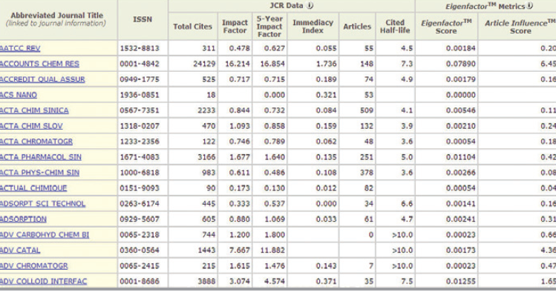
JCR now Includes Eigenfactor Metrics

Slide 9
Article Influence
Article Influence score measures the average influence, per article, of the papers in a journal. As such, it is comparable to Thomson Scientific's widely-used Impact Factor. Article Influence scores are normalized so that the mean article in the entire Thomson Journal Citation Reports (JCR) database has an article influence of 1.00.

Slide 10
Scopus Journal Analyzer
It allows searching the entire collection of journals covered by Scopus along with their SNIP and SJR metrics going back to 1999.
Source Normalized Impact per Paper (SNIP) measures contextual citation impact by weighting citations based on the total number of citations in a subject field. The impact of a single citation is given higher value in subject areas where citations are less likely, and vice versa.
SCImago Journal Rank (SJR) -- metric based on the idea that all citations are not created equal’ With SJR, the subject field, quality and reputation of the journal has a direct effect on the value of a citation.
Notes:
It is important to recognize that all these measures and several others are used to answer different questions and each will emphasize certain aspects.
Many of these measures are used in evaluation of research productivity

Slide 11
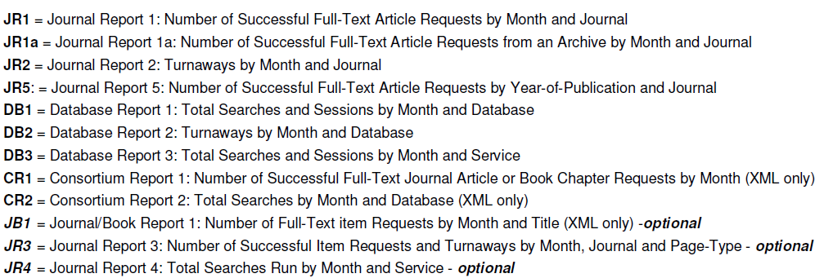
Counter Measures

Slide 12
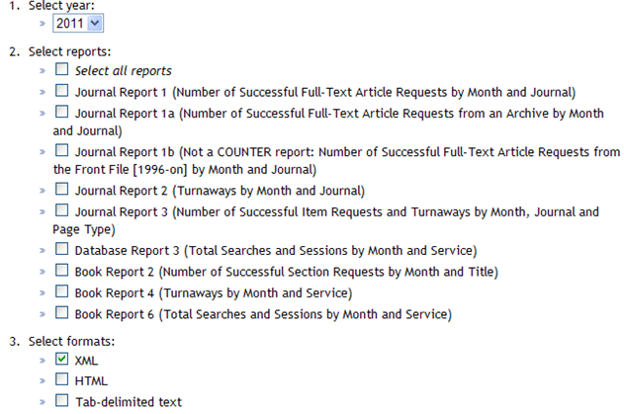
ACS Data Available to aid Decisions

Slide 13
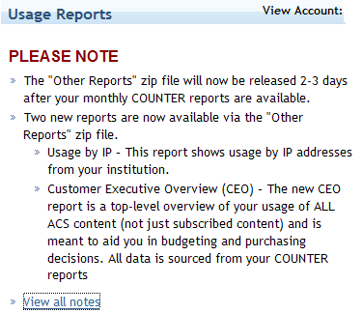
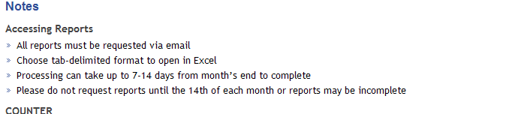
Other Reports to Aid Collection Decisions

Slide 14
How ACS Compares – Counter Report labels

Slide 15
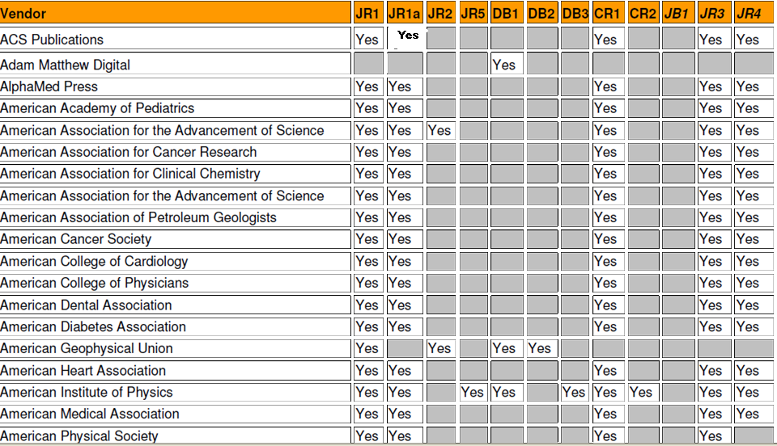
How ACS Compares Against Other Vendors http://www.projectcounter.org/compliantvendors.html
Yes
Yes

Slide 16
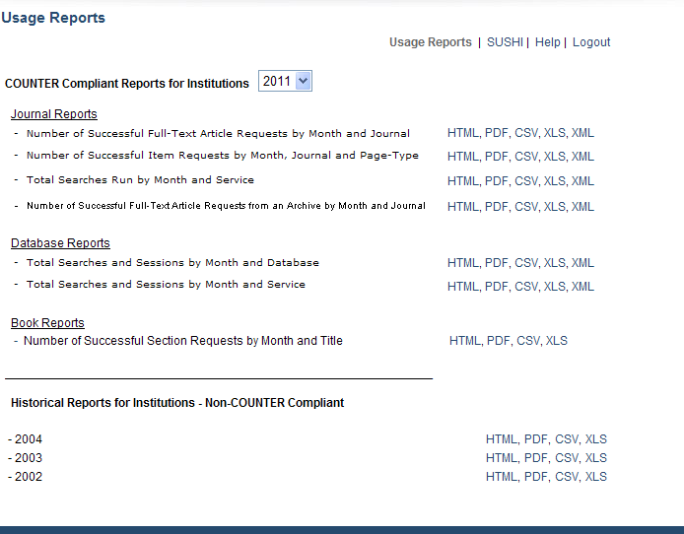
AIP Statistics
Almost same information -- Do not have to request

Slide 17
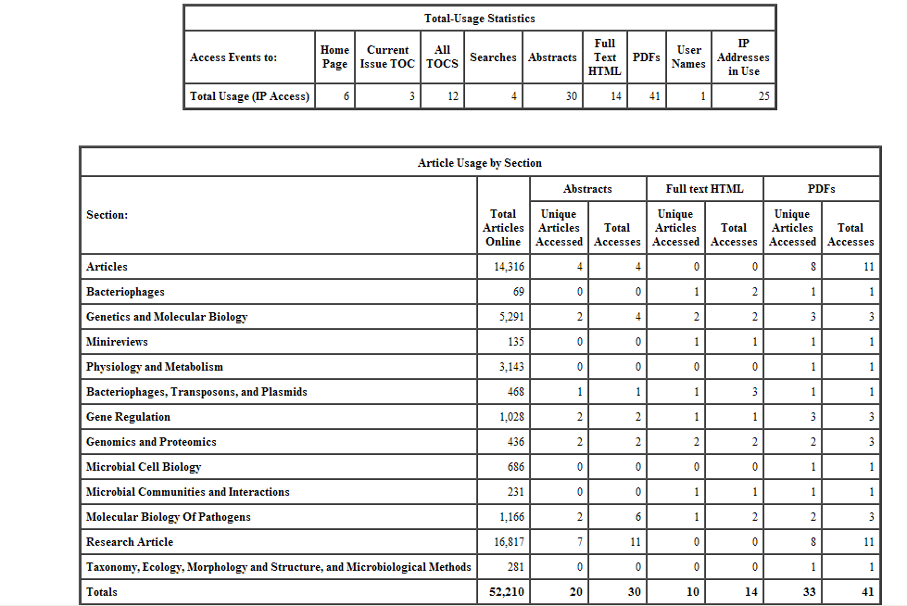
Journal of (ASM)- Extended Detailed Report

Slide 18
What is Lacking from Counter to Aid Collection Decisions
Data supplied is an overview of the journal and its use by month/year/type of page
How many articles are in the journal issue and how many was used/downloaded?
What specific articles are used?
What specific sections are used?
How many times a particular hot article was accessed from a journal?
Are a few articles contributing to high use of a journal continuously?
Others!!

Slide 19
Other Alternative Citation Measurements
altmetrics - the creation and study of new metrics based on the Social Web for analyzing, and informing scholarship
Example
  ReaderMeter computes impact indicators from readership in reference management systems, like Zotero and Mendeley

Slide 20
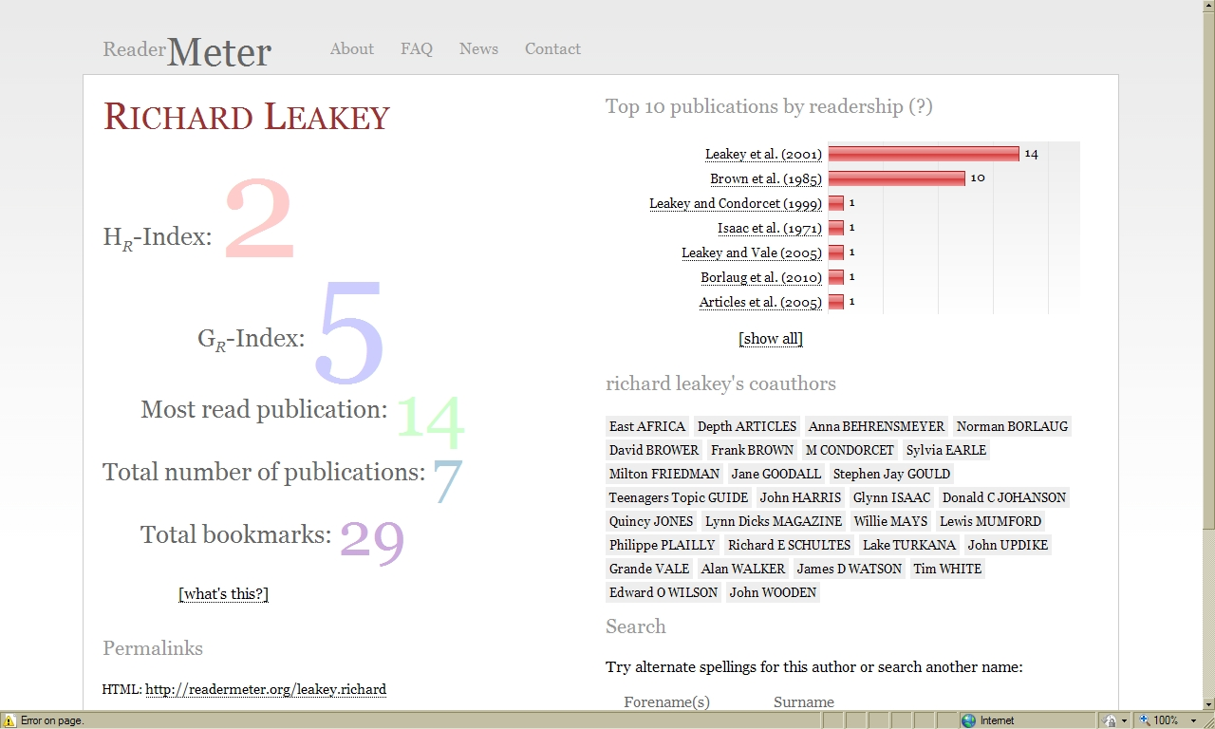

Slide 21
Measuring Value of Scholarly Publications
Peer review
Citation indexing
Author reputation
Publisher reputation
Usage statistics
  Cost per use

Slide 22
Does impact equate to local use?

Slide 23
How libraries use metrics:
No one single approach is used to make decisions!!
Online Usage data
In house use data
Citation data (faculty and journals)
Interlibrary Loan
Faculty perception of usefulness
Top journals in the field
Strength and focus of program
Librarian’s assessment

Slide 24
Examples of Using Metrics for E-Journal Selections
MIT Study
usage, cost, impact factor, MIT editors, as well as the number of MIT-authored papers and cited references for each journal
Data collected from:
own budget commitments database
local journal utilization report they purchased from Thomson
Objective Collections Evaluation Using Statistics at the MIT Libraries Willmott, Mathew and Erja Kajosalo, MIT (willmott@mit.edu). Presented at the ACS summer meeting, Boston 2010

Slide 25
MIT Study
Assigned points based on 4 performance values:
cost/use, average subject ranking, MIT papers
published, and MIT-affiliated editors.
Did not include ILL data and other measures in the study.
“The process satisfies the data-driven needs of their stakeholders, allows for clearer explanations and communications, and encourages librarians
to take a big picture view across all disciplines.”

Slide 26
Arkansas Study
To identify the research output of the science and technology department and to evaluate the comprehensiveness of the library collections in terms of where their researchers publish and what they use.
Web of Science was used as the basis for the study.
Data used in conjunction with data provided:
by vendors, in house use and ILL statistics to evaluate use of serials

Slide 27
Arkansas Study
Problem with vendor data:
ILL net lender
Class assignments where students are accessing the same article, and library instruction sessions
Source: Lutishoor Salisbury and Jeremy S. Smith. 2010. The Use of Web of Knowledge to Study Publishing and Citation Use for Local Researchers at the Campus Level. Collection Management. 35(3): 69 – 82.

Slide 28
Stanford – Peer Comparison
Journal Citation Reports to find the number of titles for a subject, compared to what is held at Berkeley
Number and cost of all titles, and cost per journal
Impact factors, e-journal usage statistics,
number of papers written by Stanford authors, number of times papers were cited by Stanford authors, and SFX report.
Getting the Biggest Bang for Your Buck: Methods and Strategies for Managing Journal Collections. Grace Baysinger, Stanford University (graceb@stanford.edu). Paper presented at ACS Summer Meeting, Boston 2010.

Slide 29
Stony Brook – Decision Matrix
Title | Impact Factor 2004 from JCR | Format | Latest Payment Cost | Cost per Use | 2005 Visits | 2005 Unique_Visitors | Rank out of 3460 used e-resources | Subject headings
Acta Neuropathologica | 2.503 | 2 | 5,375.00 | 67.19 | 80 | 24 | 634 | Histological Techniques -- periodicals.####Histological Techniques -- electronic journals####Neurology -- periodicals####Neurology -- electronic journals####Nervous System Diseases -- periodicals####Nervous System Diseases -- electronic journals####Pathol
Acta Odontologica Scandinavica | 0.884 | 3 | 379.00 | 22.29 | 17 | 9 | 1765 | Dentistry -- periodicals####Dentistry -- electronic journals##
Administration in Social Work | 0.179 | 3 | 573.68 | 33.75 | 17 | 12 | 1778 | Social Work -- organization & administration -- periodicals.##
Aids Research and Human Retroviruses | 2.375 | 2 | 2,185.26 | 49.67 | 44 | 27 | 1046 | Acquired Immunodeficiency Syndrome -- periodicals.####Retroviridae -- periodicals.####Sexually Transmitted Diseases -- periodicals##
Alcohol research & health | 0.918 | 3 | 26.32 | 5.26 | 5 | 5 | 2583 | Alcoholism -- periodicals.####Alcoholism -- electronic journals####Alcoholism -- therapy -- periodicals.####Alcoholism -- therapy -- electronic journals####Alcoholism -- prevention & control -- periodicals.####Alcoholism -- prevention & control -- elctron
Alcoholism Treatment Quarterly | 0.000 | 3 | 585.00 | 58.50 | 10 | 8 | 2148 | Alcoholism -- therapy -- periodicals.####Social Work -- periodicals##
American Journal of Community Psychology | 0.938 | 2 | 1,029.47 | 35.50 | 29 | 19 | 1394 | Community Mental Health Services -- periodicals.####Community Mental Health Services -- electronic journals####Psychiatry -- periodicals####Psychiatry -- electronic journals####Psychology -- periodicals####Psychology -- electronic journals##
American Journal of Nephrology | 1.342 | 2 | 1,863.00 | 60.10 | 31 | 20 | 1313 | Nephrology -- periodicals.##
American Journal of Reproductive Immunology | 1.808 | 2 | 1,139.00 | 87.62 | 13 | 7 | 1940 | Allergy and Immunology -- periodicals.####Reproduction -- periodicals.##

Slide 30
Use of Bibliometrics for Library ROI
Elsevier White Paper at U Illinois Urbana -Champaign
  Cost per use calculated with COUNTER statistics and annual subscription costs
U Colorado Boulder
  Utilize citation analysis
  Boulder faculty were able to obtain at least 87% of the references cited in their articles from electronic library resources.

Slide 31
Additional factors for Library ROI not from Bibliometrics
Use of space
Use of technology (Web 2.0 and beyond)
Outreach services
Collaborative endeavors

Slide 32
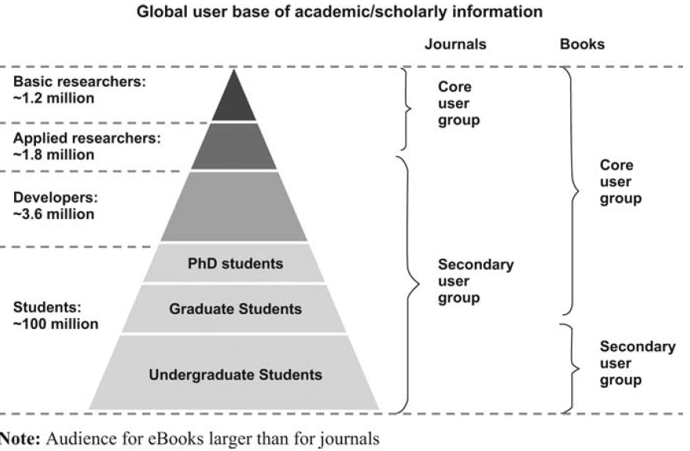
E-Books
E- Books
The future of e-Books? Will print disappear? An end-user perspective. Library Hi Tech ,Vol. 27 No. 4, 2009, p570-583
Notes:
Who uses eBooks?
In the academic and professional book market a number of groups exist. The smallest
group is basic and applied researchers, who mostly read but also write books. In
addition, developers enlarge this group. Finally a large user base of students and
developers complements the audience for academic (e)Books.
Comparison of the audience groups for scientific journals and books shows that
only the tip of the pyramid is core users who both read and write content for journals.
Thus, the audience for academic journals is much smaller than the audience for books.
Clearly, the core user group for books is bigger by far than the core user group for
academic journals.

Slide 33
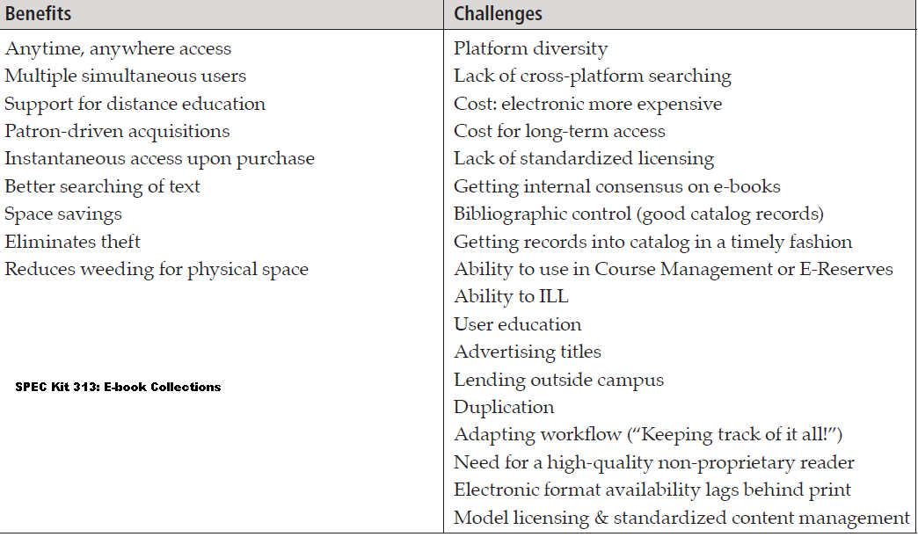

Slide 34
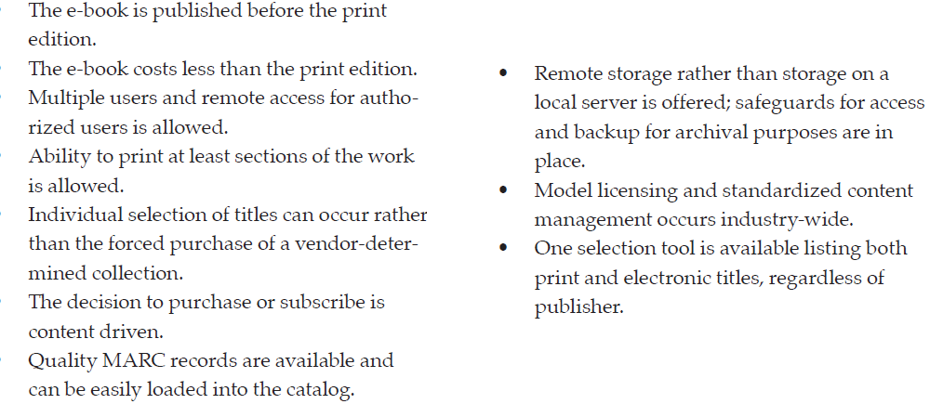
Library e-book purchase will increase if…
Source: SPEC Kit 313: E-book Collections, 2009

Slide 35
Ebrary Reports
Document ID | Title | Author | Pages Viewed | Percent Viewed | Pages Copied | Percent Copied | Pages Printed | Percent Printed | User Sessions | Turnaways | Wait Queue
2000644 | Theory & the Novel : Narrative Reflexivity in the British Tr | Williams, Jeffrey J.(Author) | 1 | 0% |  | 0% |  | 0% | 2 | 0 | 0
2000694 | Cross-Examining Socrates : A Defense of the Interlocutors in | Beversluis, John(Author) | 259 | 37% |  | 0% |  | 0% | 11 | 0 | 0
2000774 | Varieties of Javanese Religion : An Anthropological Account | Beatty, Andrew(Author) | 109 | 18% |  | 0% |  | 0% | 17 | 0 | 0
2000784 | Francophone Sub-Saharan Africa, 1880-1995 | Manning, Patrick(Author) | 39 | 5% |  | 0% |  | 0% | 2 | 0 | 0
2000793 | Descartes : The World: And Other Writings | Descartes, Rene(Author) | 2 | 0% |  | 0% |  | 0% | 1 | 0 | 0
2000808 | Autobiography & Black Identity Politics : Racialization in T | Mostern, Kenneth(Author) |  | 0% |  | 0% |  | 0% | 1 | 0 | 0
2000829 | Powers of Freedom : Reframing Political Thought | Rose, Nikolas(Author) | 79 | 10% |  | 0% | 3 | 0% | 8 | 0 | 0
2000830 | British Society, 1680-1880 : Dynamism, Containment & Change | Price, Richard(Author) | 1 | 0% |  | 0% |  | 0% | 1 | 0 | 0

Slide 36
ACS E-Book Data

Slide 37
E-Book Usage - Desirables
Number of full-text downloads by title/chapter/month/year/IP access
Full-text pages/chapters viewed, copied and printed
Full-text pages viewed but not downloaded/printed
Successful searches
Unsuccessful searches
Others?
Notes:
Usage Tracking
Eighty-three percent of the responding libraries (60 of 72) reported tracking or monitoring usage of e-books while 17% do neither. Most libraries rely on statistics provided by the e-book vendor/publisher; however these statistics vary in quality. (See the Representative
Documents section for sample reports.) The frequently collected data is the number of downloads, but other controls include pages viewed, copied, and printed; number of successful searches; and number of searches turned away. One respondent commented that the
e-book statistics “are a good indicator of use and allow
for very revealing comparisons to printed book usage.”
However, the lack of consistent presentation by
vendors and publishers not using COUNTER statistics
makes for a work-intensive project.

Slide 38
Conclusion
Libraries use a variety of methods to make selection/de-selection decisions
ACS has gone beyond the basic COUNTER best practices in providing journal use statistics

Slide 39
What can ACS do to Improve Visibility & Use
Find ways to highlight articles ACS publications that are highlighted in the media and other top journals such as science, nature and PNAS
Publish reports of such papers by institution to allow visibility of scientists nationally and on campus
Identify the times cited in SciFinder next to each article.
Show related records from ACS pubs next to each article

Slide 40
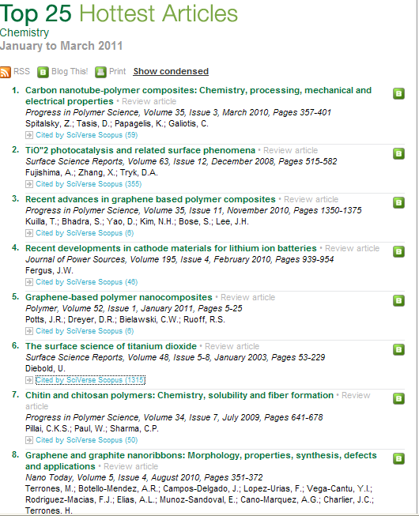
Example: Elsevier

Slide 41
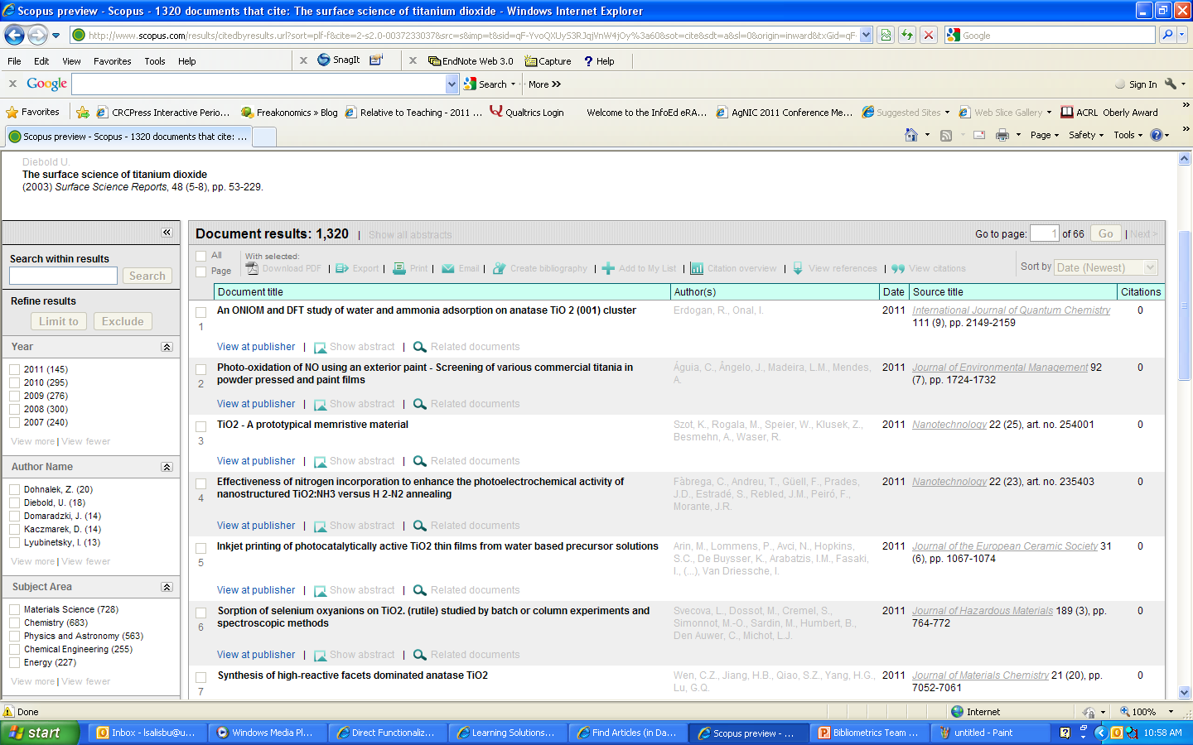
Display from SciVal Scopus from Science Direct

Slide 42
Increase visibility
Use Web 2.0 to allow users to assign ratings to articles which can be aggregated to provide rating and ranking to the article (e.g. PLos)
Identify downloads of paper next to the title of articles -- might indicate influence of a paper
Tab for institutions with top cited papers/top downloads – identify by nos. times cited/times downloaded

