Slide 1

IT Security Report (interim)
James King (NIH), Norah Xiao (USC), Jonathan Morgan (ACS), Sara Rouhi (ACS)

Slide 2
Committee Charge
  Authentication and access best practices
  Short term (2-3 years) changes
  Customer ideal expectations
  Post-cancellation rights
Notes:
What are the industry best practices related to authentication and access?
What could change or dramatically affect these best practices in the next 2-3 years?
What are the customer ideal expectations when it comes to authentication, access, and abuse mitigation?
The team also added the issue of post-cancellation rights since it seemed interrelated to access issues.

Slide 3
Approach
  Literature Search
  Customer Focus Groups
  Publisher Survey
Notes:
What are the industry best practices related to authentication and access?
What could change or dramatically affect these best practices in the next 2-3 years?
What are the customer ideal expectations when it comes to authentication, access, and abuse mitigation?
The team also added the issue of post-cancellation rights since it seemed interrelated to access issues.

Slide 4
LITERATURE SEARCH

Slide 5
Literature Search
  Breeding, Marshall, “Offering Remote Access to Restricted Resources” Information Today May 2001
  Cain, M. “Cybertheft, network security, and the library without walls” [Electronic version]. Journal of Academic Librarianship, July, 2003. 29(4), 245-248.
  Gunther, Kim, “Knock, Knock, Who’s There? Authenticating Users” Computers in Libraries March 2001
  Lu, Rongxing; Cao, Zhenfu “Efficient remote user authentication scheme using smart card” Computer Networks 2005
  Mikesell, Brian L. “Anything, Anytime, Anywhere :Proxy Servers, Shibboleth, and the Dream of the Digital Library” Journal of Library Administration 2004
  Rovner, Sophie L., “A Question Of Identity” C&EN, May 24, 2010 http://pubs.acs.org/cen/science/88/8821sci2.html
  Webster, Peter, “Remote Patron Validation: Posting a Proxy Server at the Digital Doorway” Computers in Libraries September 2002
  Watkins, Donna “Access Without Authentication: How and Why we let Anyone Surf our Wireless” Computers in Libraries March 2006

Slide 6
Literature Search - Summary
  From library perspectives
  “Library without walls”
  “In a perfect world, network security wouldn’t exist. It’s a barrier and, generally speaking, has an inverse relationship with functionality. Librarians and other users of information systems usually find network security to be a nuisance. But just as we understand we should lock our cars when we leave them in parking lots, so we know that we must secure our networks” (Cain, 2003)

Slide 7
Key to success
“Authentication, Authorization and the Proxy”
Remote authentication methods (2005)
  Proxies requring users to configure browser settings
  Ezproxy
  Onelog
  Virtual Private Networks
  Athens
  Shibboleth
  Smart card

Slide 8
FOCUS GROUPS

Slide 9
Focus Groups
  Sara Rouhi held a round of customer focus groups including questions about their ideal expectations when it comes to authentication options and responding to online abuse detection.

Slide 10
Summary of Focus Group Findings
Three separate groups:
Consortia, University, and Corporate:
Sue Jones, The Dow Chemical Company, new CAP Member
Kristen Eilts, Archer Daniels Midland
Luray Minkiewicz, DuPont
Felice Maciejewski, University of Wisconsin Consortia
Cindy Clennon, CARLI Consortia
Jeremy Garritano, Purdue University
Chuck Huber, UC Santa Barbara, Former LAB member
Gwen Owens, Georgetown University

Slide 11
CORPORATE
Seeking alternatives to IP Authentication because of frequent mergers/divestitures and global workforce
Metrics: What are business units using?
Abuse is extremely rare (peer pressure)
Dream solution: Connect my users anywhere on any device
I NEED MORE INFO! Aka: What do we have access to?
Post-cancellation? There needs to be an online solution

Slide 12
CONSORTIA
Some schools trying ONE login/password authentication
Ebooks ebooks ebooks
No groundswell yet for mobile devices
Abuse monitored locally – rarely are consortia in the know
Post- cancellation: CDs are not an option – it’s like not getting the content at all

Slide 13
UNIVERSITY
EZProxy vs. VPN – security
Privacy rights vs. abuse investigation
Abuse happens rarely – no educational moment
Best practices: CAS – more targeted/nuanced response
Recommendations: Note a campus’ EZ Proxy IP and think twice before shutting off
Post cancellation: PORTICO is an acceptable alternative (i.e. Springer) – most vendors allow access via their platforms as long as canceled customer is paying to access something

Slide 14
CUSTOMER QUESTIONS
Is ACS planning on changing its licensing terms re: post-cancelation access?
Is ACS open to data mining research/projects on a case-by-case basis?
Questions?

Slide 15
PUBLISHER SURVEY

Slide 16
Publishers
    AAAS (Sara)
    AIP/APS (Norah)
    Elsevier (Norah)
    IEEE (James)
    Nature (James)
    OSA (James)
    PNAS (Sara)
    RSC (Norah)
    Springer (James)
    Wiley (James)
Notes:
AAAS (Sara)
AIP/APS (Norah)
Elsevier (Norah)
IEEE (James)
Nature (James)
OSA (James)
PNAS (Sara)
Royal Society of Chemistry (Norah)
Springer (James)
Wiley (James)
Note that Sara will be contacting another ACS CAP member to contact these publishers to reduce potential conflicts.

Slide 17
Publisher Survey
  What IP blocking techniques to you use?
  What authentication methods do you support?
  If a potential abuse is flagged, how do you respond?
  If a block is implemented, what is the process to restore access?
  How do you support non-IP based access?
  How are you supporting mobile device access to content?
  How are you supporting remote access to content?
  How do you handle post-cancellation rights?
  How has new technology like federated search and download harvesters affected your access blocking?
Notes:
What IP blocking techniques to you use?
Spider Traps: These are hidden links on some pages that a human being would never click on, but Web crawlers would follow when someone attempts to download large quantities of our content. The IP address of the user who hit the spider trap is blocked.
More than X downloads in a session: If more than X full-text HTML or PDF downloads occur in a single session, the IP address associated with that session is blocked.
More than X sessions in X minutes: This rule is intended to thwart abusers who have figured out the X download limit per session, and attempt to spawn multiple sessions to conduct a massive download.
Session duration longer than XXX minutes: It is intended to stop abusers who try to perform a massive download by throttling the downloads to a slower pace, but running for a long time.
What authentication methods do you support (IP authentication,OpenID, etc. – what other ones to add?)
If a potential abuse is flagged, how do you respond?
Notify primary POC
Block access to that address
Block access to entire domain
Throttle access down
Other
If a block is implemented, what is the process to restore access?
How do you support non-IP based access?
How are you supporting mobile device access to content?
How are you supporting remote access to content?
How do you handle post-cancellation rights?
Lose access to all online content
Provide a disk with subscribed content
Retain online access to specific years and titles subscribed during online subscription term
Retain online access to all titles from online subscription start date until cancellation date
Retain online access to all current and archival content up through last subscription year
How has new technology like federated search and download harvesters like Quosa and PubGet affect your access blocking?
We agreed that in return for a publisher sharing their information, we would provide a summary of the best practices we found. This summary will be reviewed and vetted by the team (and ACS) first.

Slide 18
Publisher Survey - Responses
AAAS - Waiting for answers
AIP/APS - Report received
Elsevier - Report received
IEEE - Report received
Nature - Not contacted
OSA – Report received
PNAS - wants mutual sharing
RSC - No
Springer - Awaiting decision
Wiley - Waiting for answers

Slide 19

Feedback - APS
  BP: automate as much as possible, IP access using home-grown system, few u/p, no others
  2-3 yrs: IPv6 and Open Access could both affect short-term
  Ideal: Accurate stats and seamless access; incl. log files with abuse notification; timely response to queries
  IP blocking: homegrown algorithms with mix of usage and thresholds – can be restored by minor user or with librarian contact for major issues
  Post-cancellation: requires archive subscription
  Other: Not noticed issue with PubGet or Quosa

Slide 20

Feedback - Elsevier
  BP: U/P common in online business but Google’s openness doesn’t care about authentication
  2-3 yrs: Digital Signatures and chips/smart cards
  Ideal: Streamline access while tracking usage within an org, handle abuse gracefully and specifically
  IP blocking: Use blacklisting and continuous IP validation
  Post-cancellation: lose access
  Other: Support IP, U/P, Federated Authentication (Shibboleth), don’t support federated searching nor mobile

Slide 21

Feedback - OSA
  BP: IP access, Federated Searching, Google indexing
  2-3 yrs: Article linking via Google, mobile viewing
  Ideal: Simple, seamless access
  IP blocking: More than x downloads in a session triggers block
  Post cancellation: provide disk
  Other: Magazine has U/P for mobile

Slide 22
Feedback - IEEE
  BP: IP access, U/P, Athens & Shibboleth
  2-3 yrs: IPv6, social network auth, OpenID, mobile auth
  Ideal: Secure and seamless, location independent, merge individual with institution creds, self-directed admin, granular stats, proactive alerting on abuse
  IP blocking: More than x downloads in a session, in x minutes, and longer than xx minutes
  Post cancellation: provide disk, keep access to subscribed
  Other: support and track federated searching, little activity from harvesters; mobile thru existing channels

Slide 23
American Chemical Society
  Authentication Options
    IP access, username/password, Shibboleth, single sign on across ACS Web properties
  Exploring additional options (2-3 yrs)
    Mobile device pairing, ORCID integration, Facebook credentials, OpenID, IPv6, account level settings/configurations
  Ideal environment
    Secure and seamless, location independent, merge individual with institution creds, granular stats, proactive alerting on abuse
  IP blocking methods
    Spider trap, excessive downloads, excessive session creation, excessive session duration
  Post cancellation
    Provide disks, maintain access to subscribed
  Other
    Carefully monitor all site activity (not limited to full text downloads) and report out to business and IT units on anomalies

Slide 24
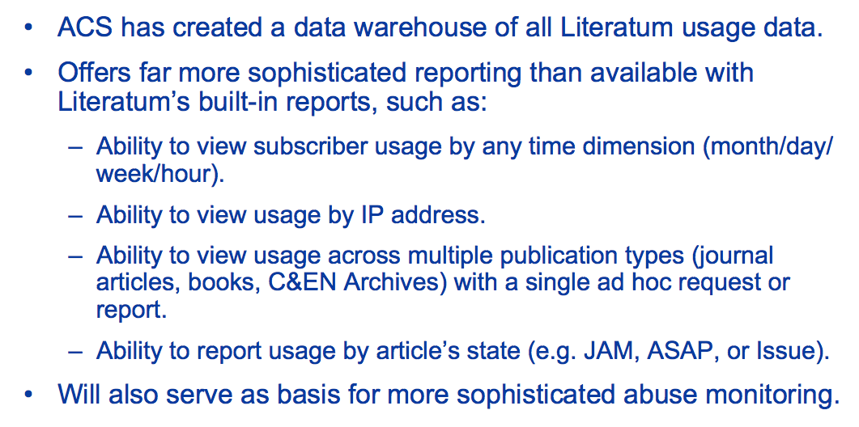
Under Development: Advanced Analytics and Abuse Monitoring

Slide 25
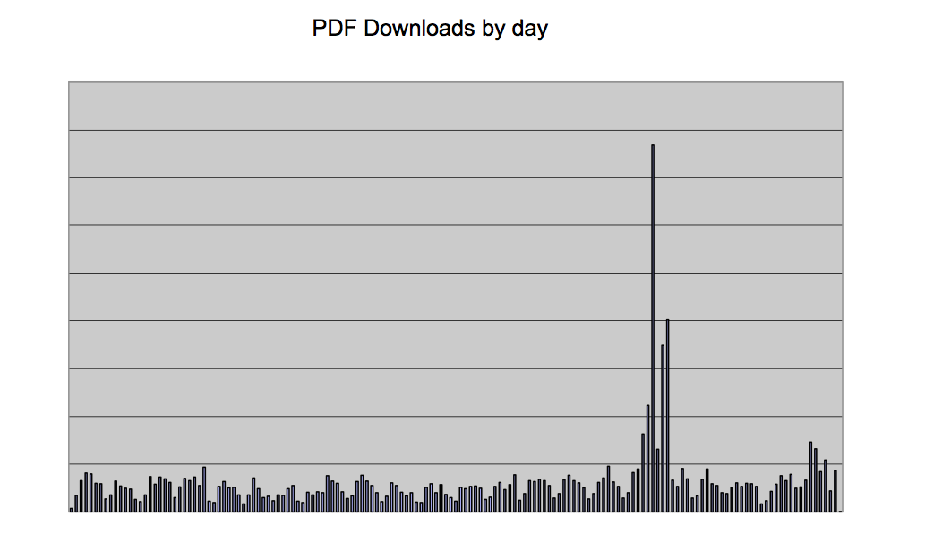
Under Development: Advanced Analytics and Abuse Monitoring

Slide 26
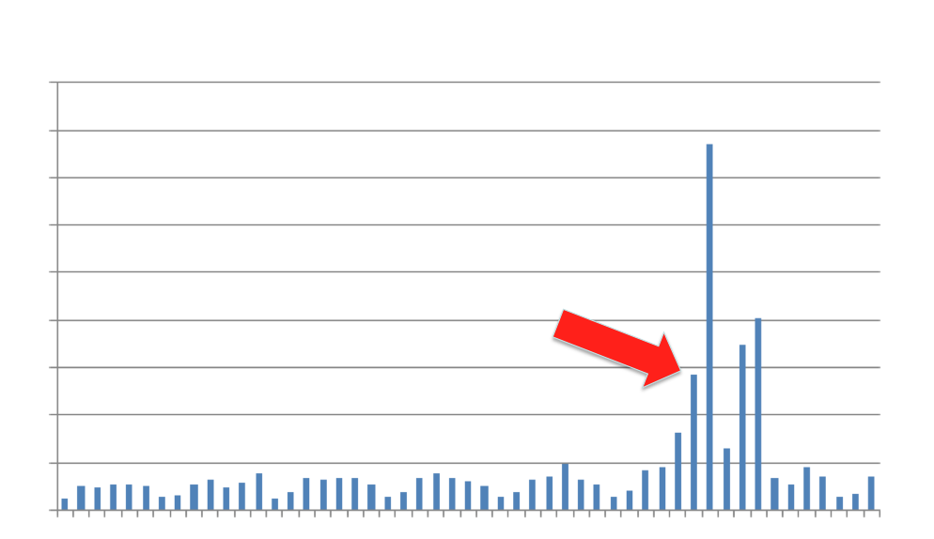
Desired Outcome

Slide 27
TRENDS

Slide 28
Trends that could impact
  Non-IP Authentication
    Cornell has developed and is starting to use ‘passkey’ (https://confluence.cornell.edu/display/CULLABS/Passkey+Bookmarklet)
  ORCID
  Mobile Devices

Slide 29
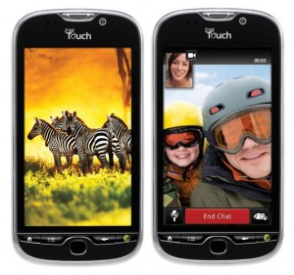
Notes:
This is my new smart phone, an Android My Touch. I previously had a Blackberry Bold and I must admit that this new device has dramatically changed my habits in a short period of time. Rather than simply viewing the handheld as an e-mail reader (which the Blackberry is great at), the Android is becoming my mobile computer and gateway to the cloud. Because of this device, I’ve now switched my master to do list for all parts of my life (work, home, church, SLA, etc.) to Toodledo – a web and mobile application to manage tasks. I’ve also switched personal notes, new photos and documents I’m working on to a secure file sharing service called DropBox. These cloud services are enhancing my mobile experience and encouraging me to use it more.
Just downloaded Google Docs app which can take a picture of a document and make it editable!
The NIH Library has made a strategic goal to build a mobile competency in the staff over the next couple years. This is being accomplished by providing mobile devices to the entire staff (some with phone service and others with just data plans), holding brown bag sessions to help each other learn new features, and hosting a Mobile Technology Expo earlier this month. We’re also using this initiative to make our own library Web site mobile-friendly and to build a collection of links to mobile versions of the journals and databases we provide. We feel that we need to first have a basic understanding of the technology and try to do our own job with a mobile device so that we can see the barriers that we’re imposing on using mobile with the library’s services. Why the big focus on mobile?

Slide 30
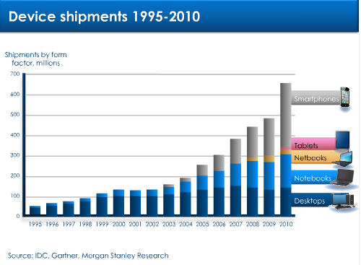
http://www.morganstanley.com/views/perspectives/tablets_demand.pdf
Notes:
As you can see from this chart, In 2010, over 80% of all shipping devices were mobile so the stationary desktop computer is quickly becoming a minority to its mobile cousins the netbook, notebook, table, and smartphone.

Slide 31
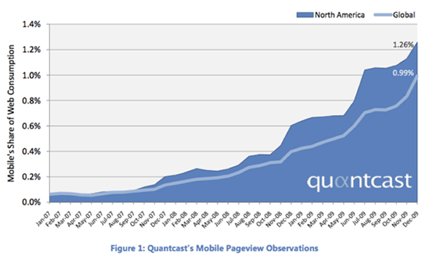
http://techcrunch.com/2010/01/05/quantcast-mobile-web-apple-android/
Notes:
Though this chart only shows from 2007-2009, you can see a dramatic growth in mobile web usage in that time. With the explosive growth of smartphone and tablets since then, I expect that the percentage will go higher quickly. In fact, many are predicting that mobile will be the primary access by 2020.
When I was at the Drupal conference earlier this year, the key developer told an audience of 3,000 that if they were building the massive open source content management system today rather than 10 years ago, it would have been a mobile-focused effort – a testament to where connectivity is heading in the near future.

Slide 32
Mobile Visits Accessing ACS Web Editions Platform
Notes:
Another exciting trend we’re seeing is in the remarkable growth of mobile usage of the platform
There has been a dramatic difference in the traffic the site received in 2009 and 2010
Apple devices have really led the way in this department – the iPhone, iPod, and the iPad, which in just 9 months after launch was already in the 2nd position on this chart
Another thing to note on this chart is the growth in visits from devices running the Android OS
5 fold increase 2009 – 2010
Acs mobile app exceeds 500K abstract downloads

